Slide 1
Stacy Rosenthal, RJE Cohort 2 – May 2025

Slide 2
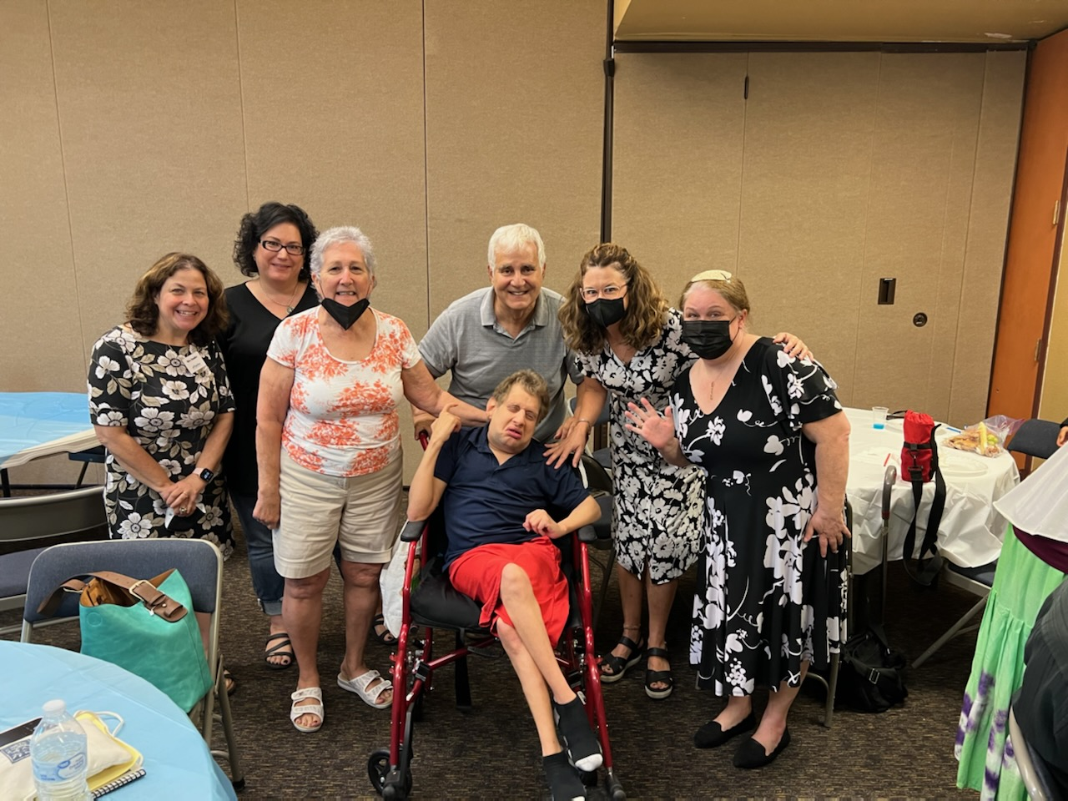
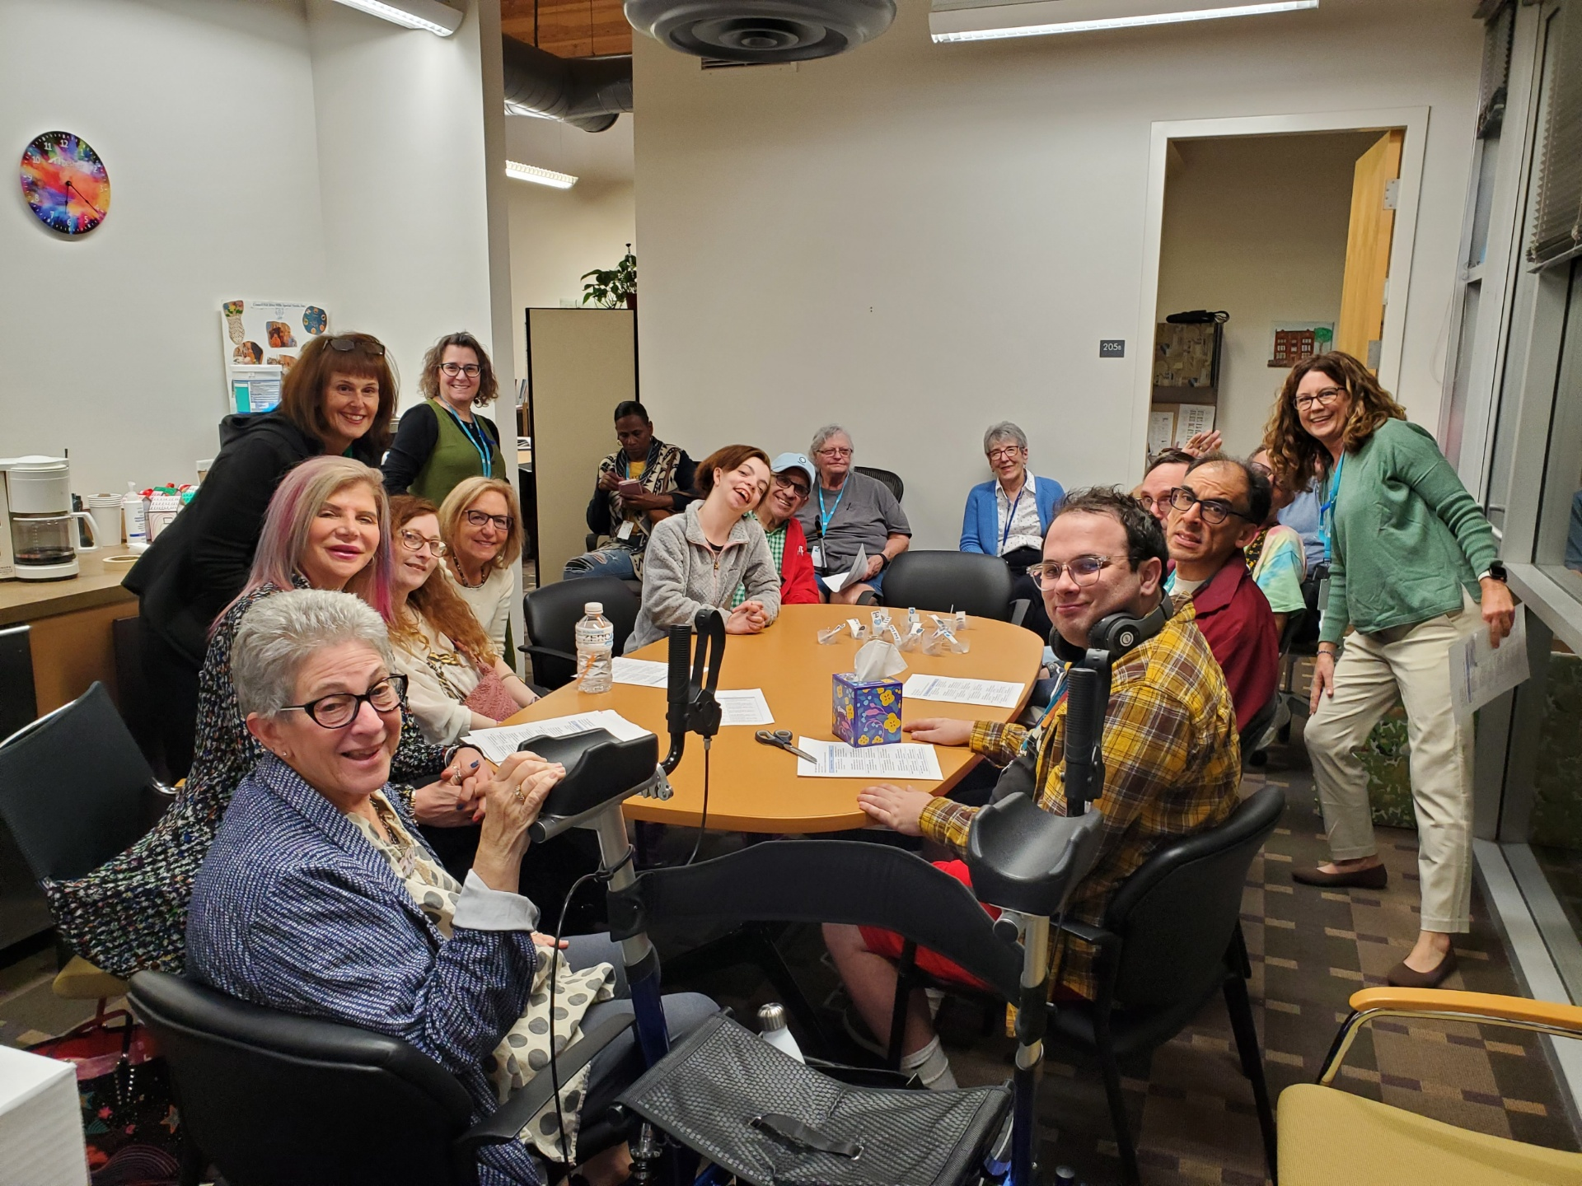
Everyone deserves the opportunity to grieve and mourn in a community that allows them to talk about death, Jewishly.

Slide 3
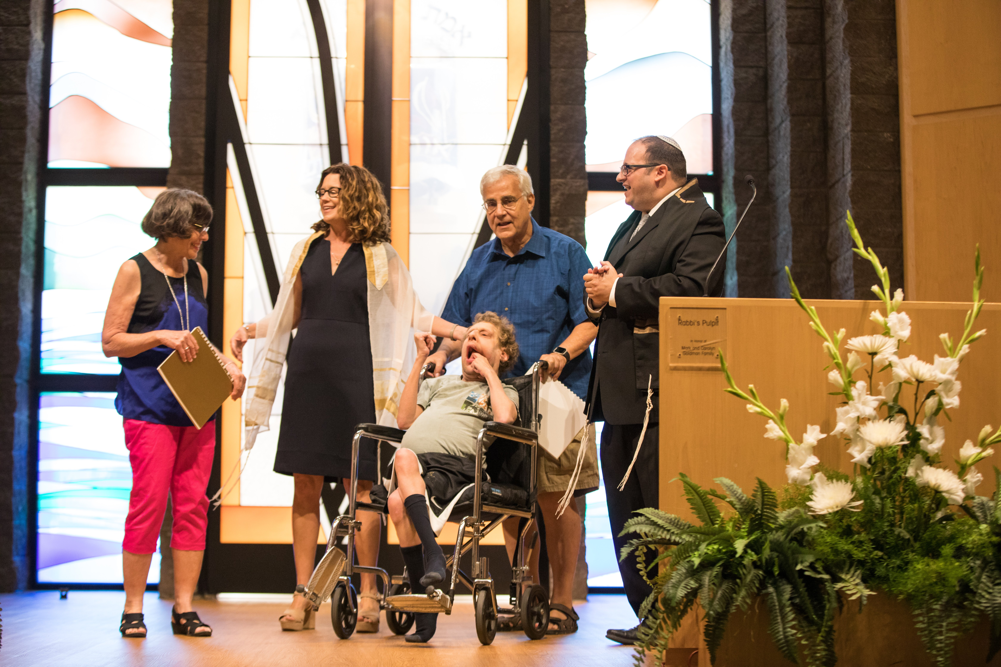
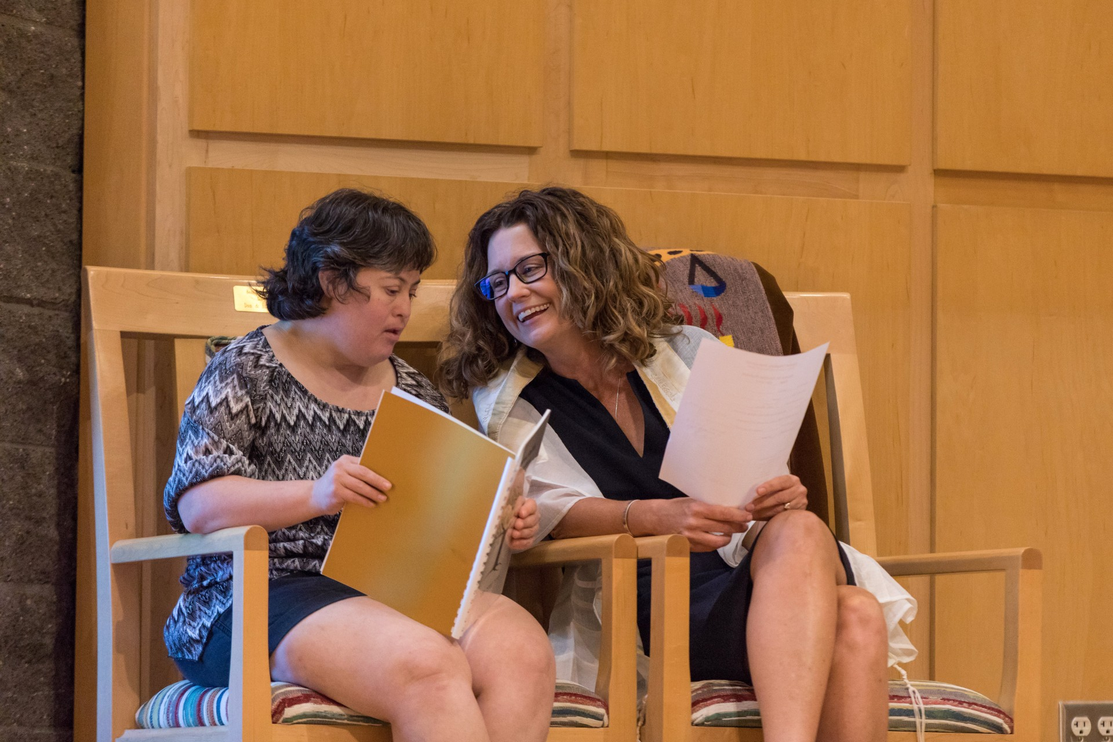
Dedicated to the loving memory of our Gesher friends
Jared K. z”l
May their memories forever be a blessing.
Leila W. z”l

Slide 4
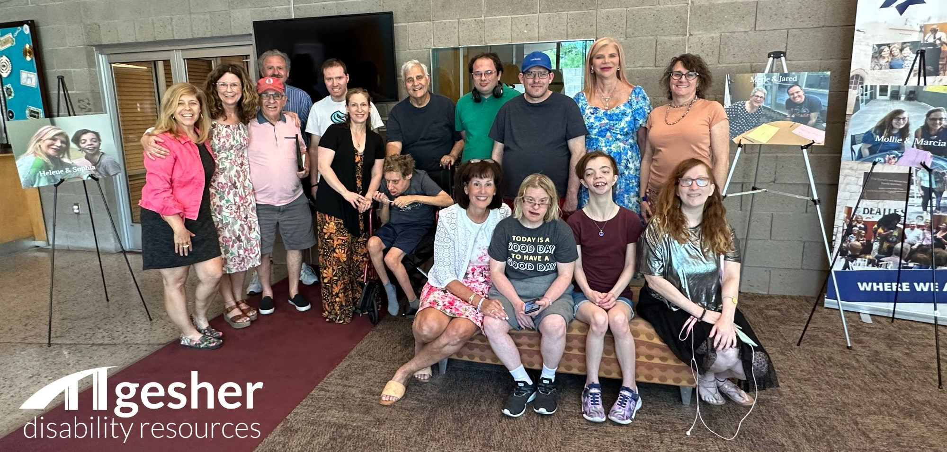
Our reasons why

Slide 5
Gesher Disability Resources (Gesher) serves the greater Phoenix Jewish community, serving children and adults affected by a disability through inclusion assistance, resource referral, residential support, Jewish programs and social groups.
Gesher Disability Resources

Slide 6
Forty Years of Providing a Jewish Community
This year, Gesher is celebrating our 40th anniversary. We have served some of the most medically fragile members of the Greater Phoenix Jewish community over the years. With advances in medical technology, we are seeing many of our members outliving their expected lifespans. Some of our members have been part of Gesher for the entire 40 years we’ve been in existence and are really more like family. Many are now in their fifties.
This past year, we lost two of our longtime members. Both were 43 years old and died within 3 months of each other.

Slide 7
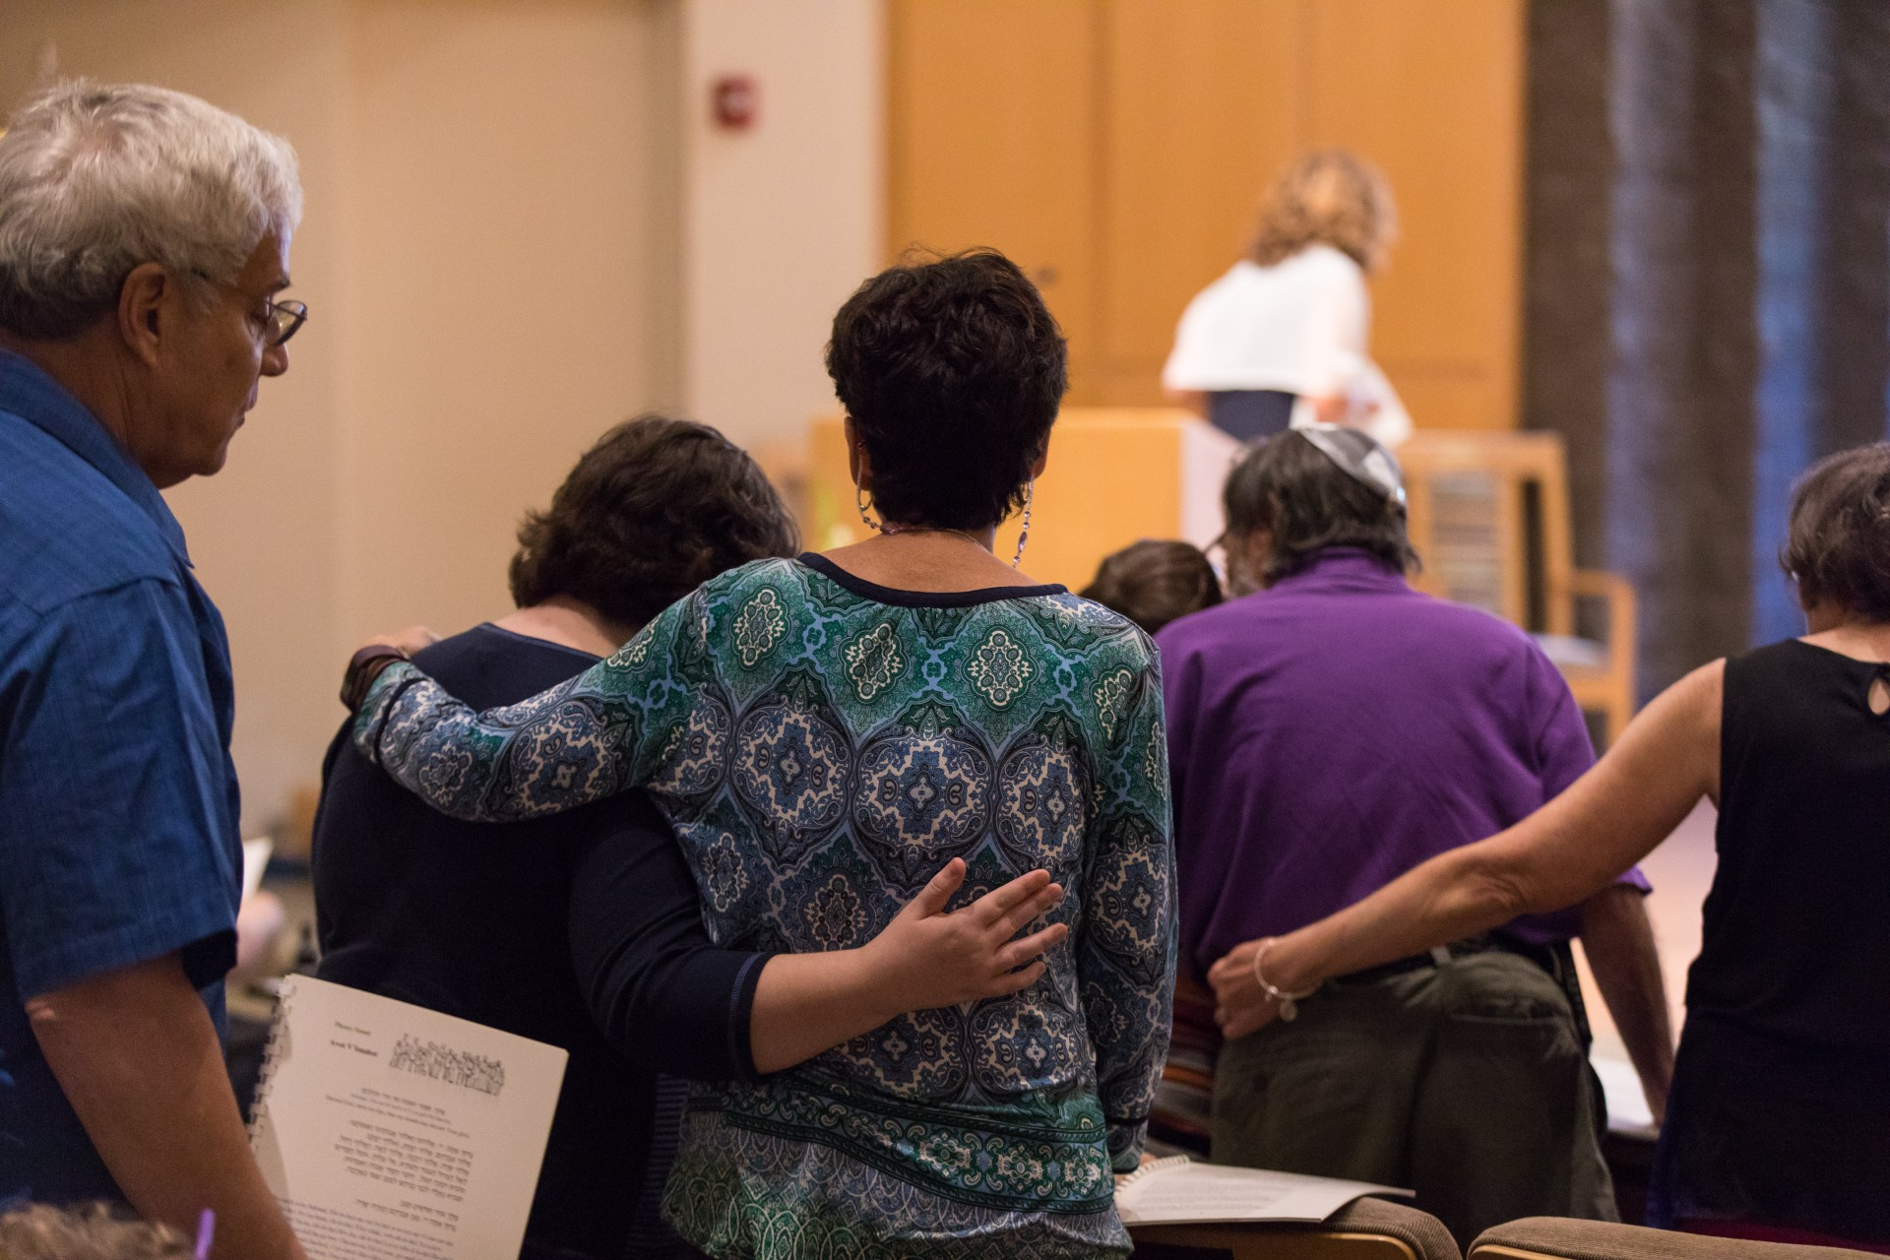
We needed to discuss death and grief with our members . . .
We looked for resources specifically designed for adults with disabilities and for those who love them. We were unable to find the materials we needed, which led us to Shomer Collective.
This project is designed to support mourners of those in the Jewish disability community.

Slide 8
When Jared and Leila died, we did what we could to meet with and support our members and their families.
Our members experienced different levels of grief, depending on their levels of independence. They had a lot of questions about death and dying.
Meanwhile, parents and family members were struggling with the losses of those who were like their own children. There was an elevated level of concern about not only their own mortality, asking, “What happens to my adult child when I die?” There were also a lot of big emotions as they thought about their own loved one’s fragility.
The program we designed is shared in the following slides. Many of the pictures are of our Gesher members attending different events. We did not take pictures during these sensitive times.

Slide 9
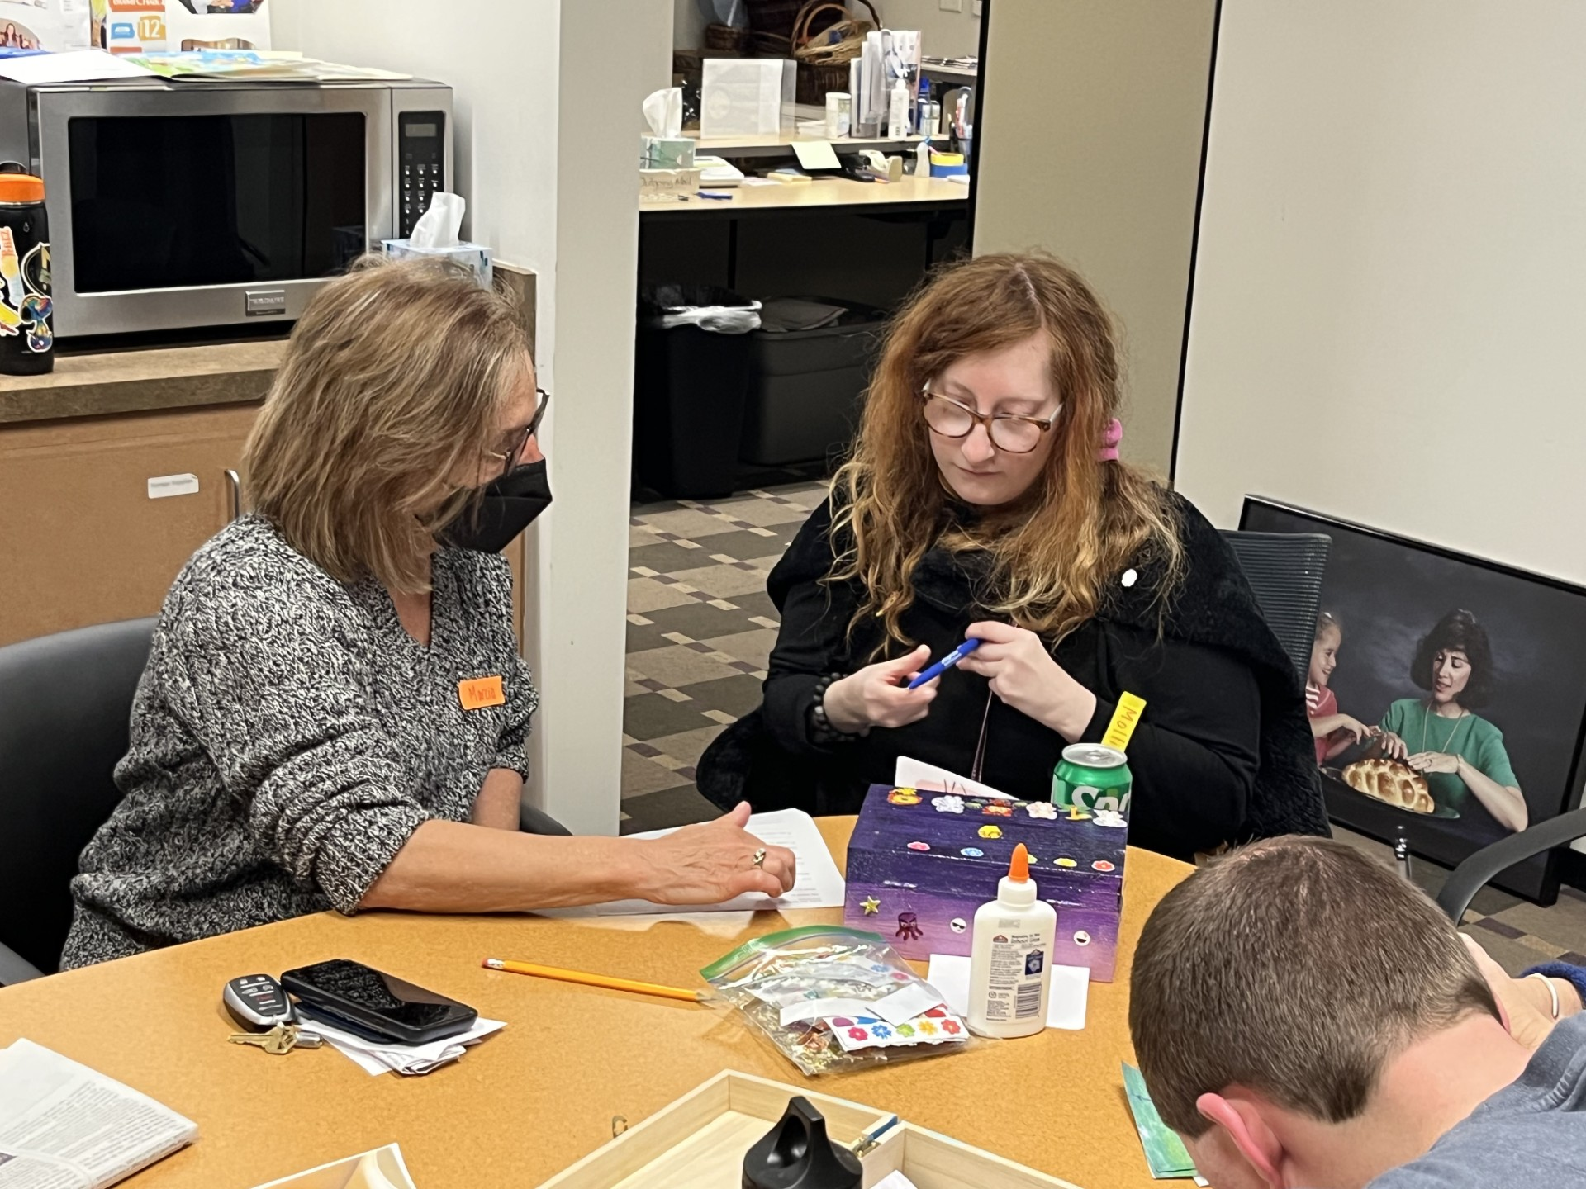
Setting:
We set out to create a program for our members in a familiar space – our Gesher offices.
This was offered to our most independent members, who were able to express their feelings in a safe space.
The examples of what we did can be duplicated in different settings. They are designed to each be done in a 60 minute session but can be adjusted, depending on the needs of the individual community.

Slide 10
Initial questions and learning outcomes
We started by asking,
What are the needs we are trying to address?
How do we ensure that what we are designing is focused, intentional and impactful for our members?
We considered who our learners were, their developmental stage and their prior knowledge.
We designed specific, observable outcomes for our participants.
From this, we designed activities to give our learners the opportunity to reach these outcomes.
The following slides detail our Learning Goals . . .

Slide 11
Learning Goals
1. Understanding Death:
Participants will understand that death means the body stops working and that the person is not coming back
Participants will be able to name ways people may die (Give examples such as: old age, illness, accidents) using simple language

Slide 12
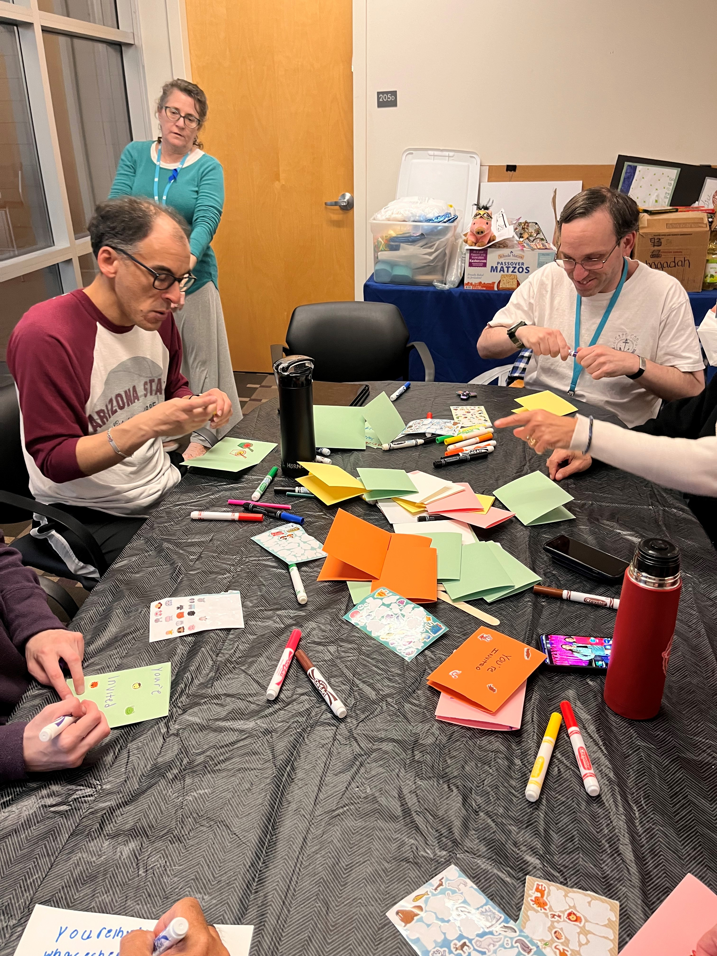
Activity #1 – We Remember
With a typical population, this activity might be done by setting up chairs in a circle. For many of our members, who are neurodiverse, it’s more comfortable to have them at the table, where they are together, but not having to make eye contact.
1. Talk about death: What does it mean when someone has died? Use simple language. Their bodies stop working. They are not coming back.
2. How do people die? (Illness, accidents, their hearts stop working, old age)
3. Talk about loved ones and friends who have died. Write or draw what you will remember about them.

Slide 13
Learning Goals
2. Understanding Grief:
Participants will identify different types of emotions they may feel when someone dies (sadness, anger, confusion).
Participants will learn that grief looks and feels different for everyone and that there is no set timeline for grief, although they will feel better over time.

Slide 14
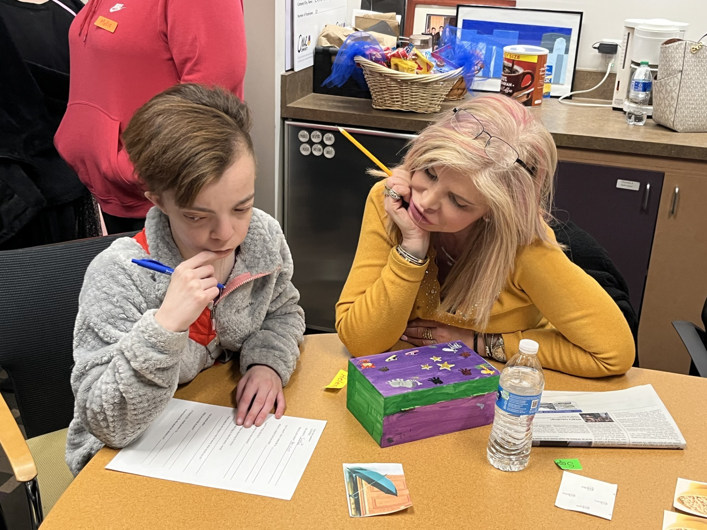
Activity #2 – Grief
1. Meet with staff or volunteers to discuss how to help participant process grief. Review entire activity with them before you start. If possible, create 1:1 pairing between staff/volunteer and participant.
2. Discuss different feelings you might have when grieving (sadness, anger, frustration, etc.)
3. Explain that all these emotions are normal and that you may have some, all, or none of these feelings. Also emphasize that grief looks and feels different for everyone and that there is no set timeline for grief, although they will feel better over time.
4. Write or draw how grief can make you feel.

Slide 15
Learning Goals
3. Expressing Feelings:
Participants will learn and practice ways to express their emotions (i.e. talking to a trusted adult, drawing, journaling).
Participants will learn techniques to identify tension in their bodies and will learn different techniques to cope such as breathing, music, drawing.

Slide 16
Activity #3 – Yoga and Movement
We invited a yoga and meditation instructor to speak about how our bodies feel when we experience different emotions. She taught techniques to identify tension in our bodies and we learned different techniques to cope such as breathing and stretching.

Slide 17
Learning Goals
4. Remembering the Person Who Died:
Participants will explore meaningful ways to remember a friend who died (i.e. share stories, make a memory box, draw a picture).
Participants will learn that remembering someone can be comforting.

Slide 18
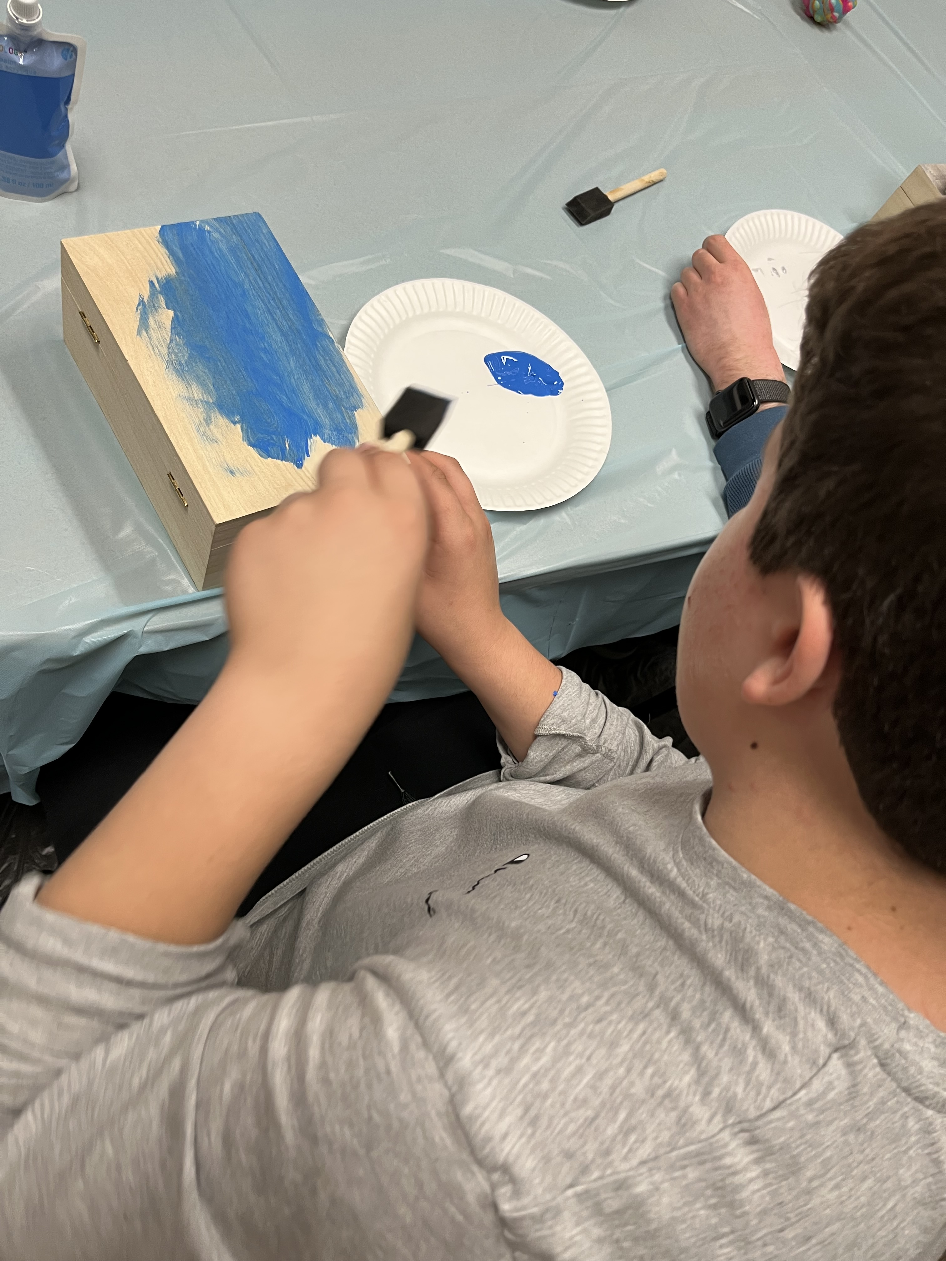
Activity #4 – Memory Boxes
For this activity, we purchased wooden boxes from a big box craft store. Our participants painted and decorated the boxes.
We discussed the memories we had of our friends and loved ones, sharing stories and what we “loved most” about them.
With help from volunteers and staff, we wrote out stories and drew pictures to remind us of those we had lost and put the memories in their memory boxes.

Slide 19
Learning Goals
5. Support Systems:
Participants will identify at least one adult to talk to when they are feeling sad or overwhelmed.
Participants will learn that it’s ok to ask for help.

Slide 20
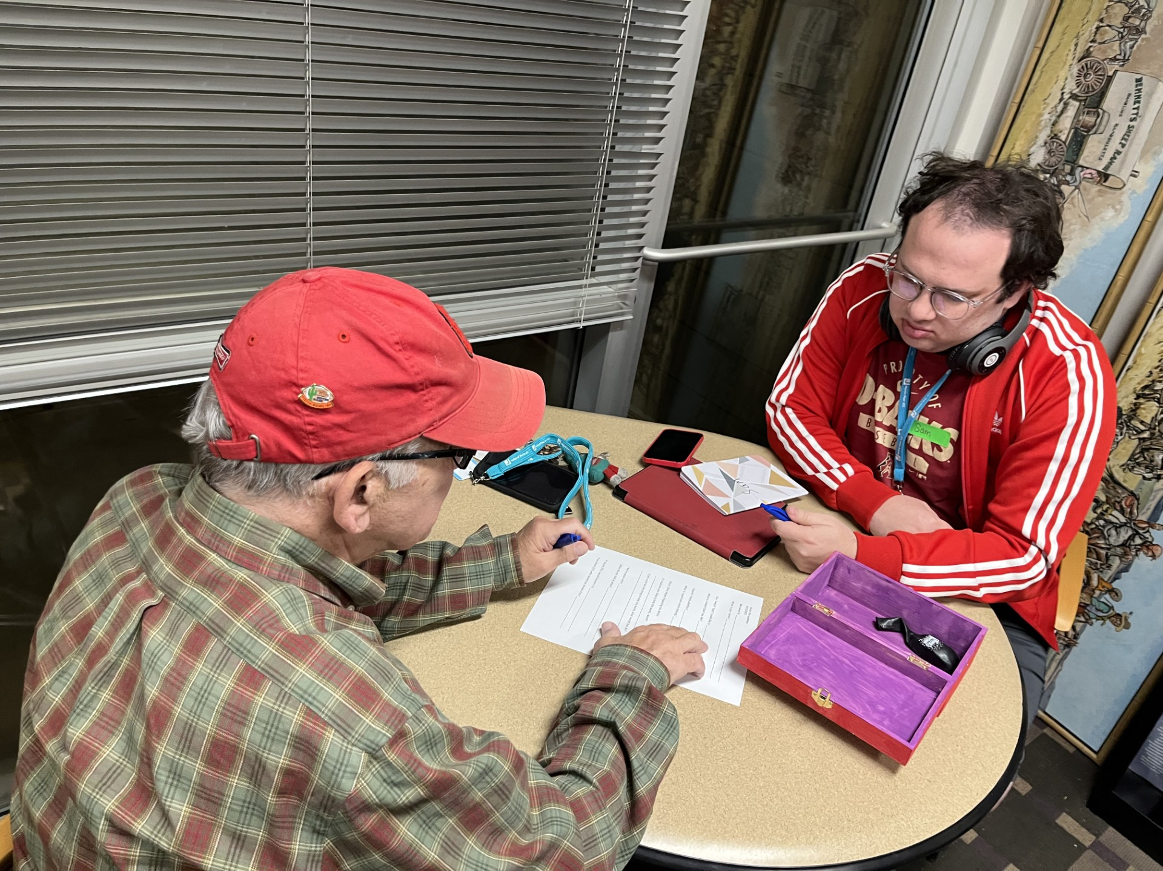
Activity #5 – Find the Helper
Discuss, as a whole group how grief can feel different at various times. We talked about how we should have at least three people who we know we can call if we are overwhelmed by big feelings.
With staff and volunteers, we made lists of “helpers” with contact information, explaining that these are people who they can call anytime they need to talk.
This information was also added to memory boxes.

Slide 21
In addition to the activities listed on previous slides, we discussed Jewish customs on death and dying with our members. Presented in a matter-of-fact way, we shared honestly what happens at a Jewish funeral and after, describing the steps:
Service – what to expect.
Burial – mourners help by symbolically placing dirt in the grave.
Shiva – how we comfort the mourners
Visiting the grave – share the practice of placing a stone on the grave

Slide 22
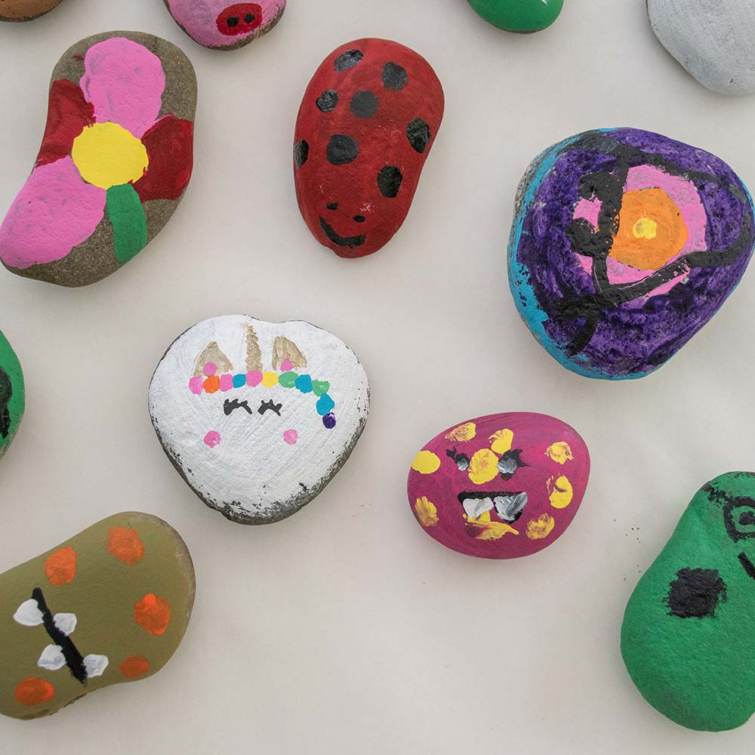
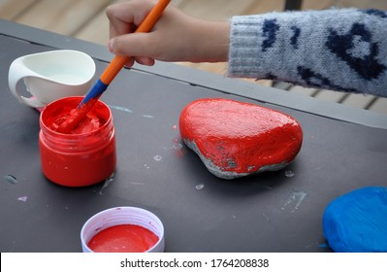
Activity #6 - Discuss Jewish burial practices and paint rocks to leave on the graves of remembered friends.
Photo credit: Home Depot

Slide 23
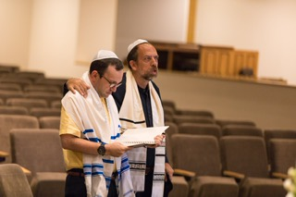
Activity for Mourners: Share Jewish mourning practices during monthly Gesher Shabbat Service (Simchat Shabbat)
Discuss what the Kaddish prayer means and why we say it. Explain that even if you can’t read, you can still participate by being present for the prayer and adding “amen.” This turns a singular prayer into a communal prayer.
We say Kaddish each service and give our members the opportunity to share the names of those who they are missing and remembering.

Slide 24
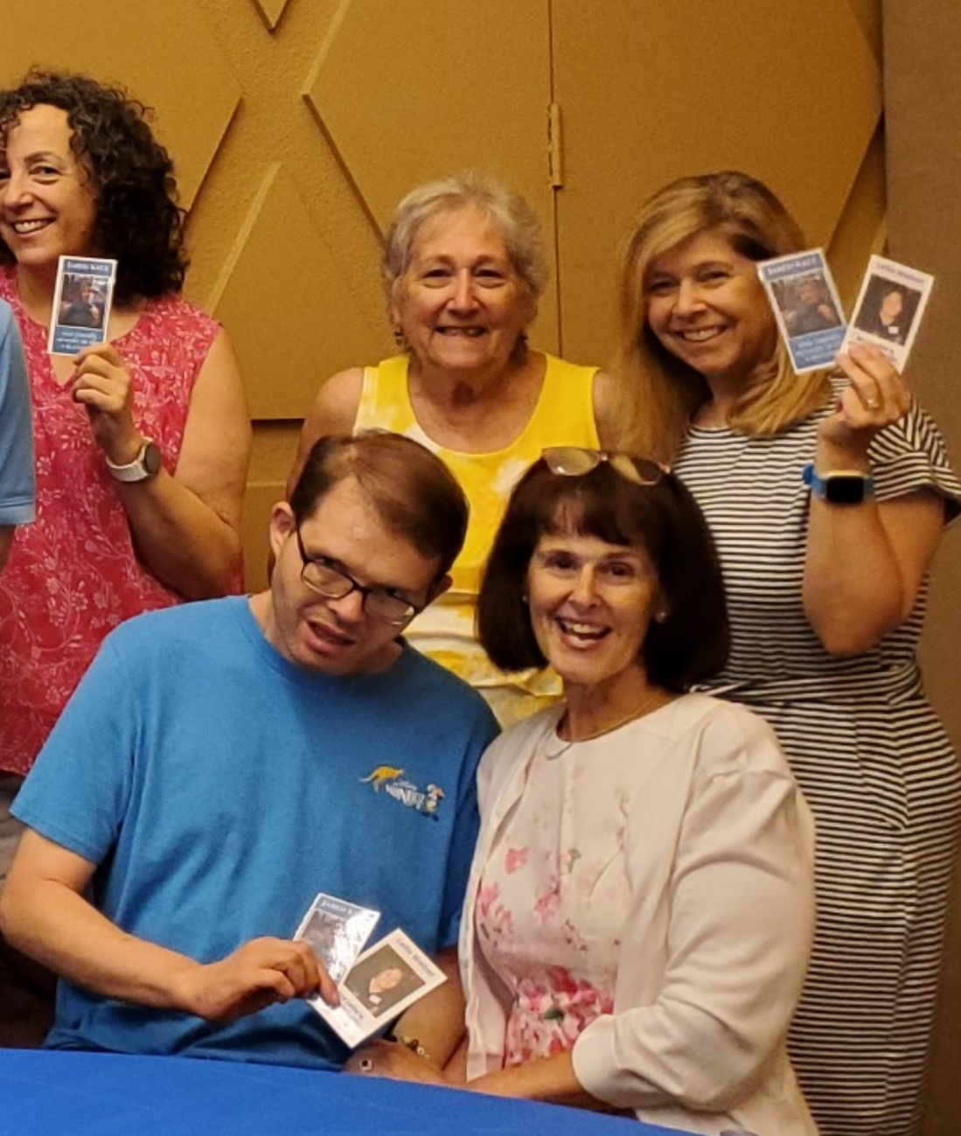
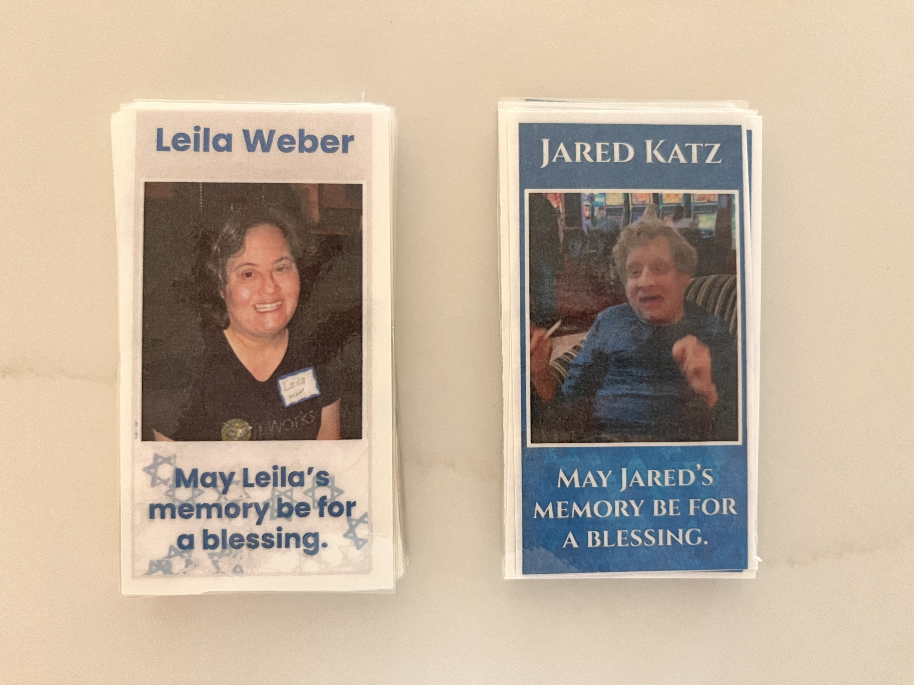
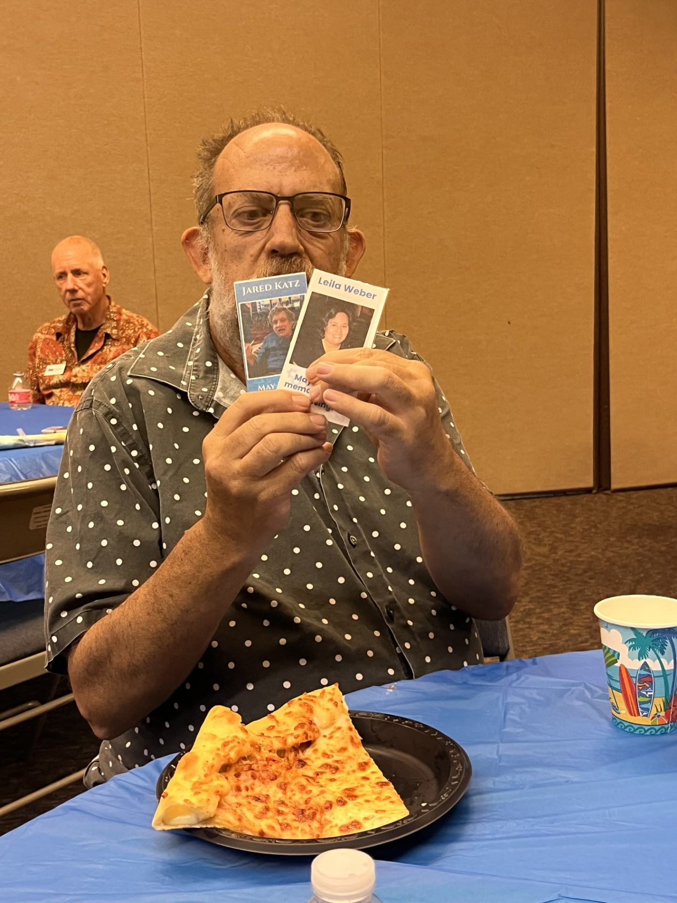
Activity for Observing a Yartzeit
For the one year anniversary (yartzeit) of Leila’s and Jared’s death, I made laminated cards to give to our members who attended Simchat Shabbat, our monthly Shabbat service for the Phoenix Jewish special needs community. Some mentioned placing the cards in their memory boxes. We share memories of our friends during the Kiddush lunch and invited Jared’s and Leila’s parents to share a story about their children.

Slide 25
קרוב Keruv/Inclusion We believe in welcoming members with various levels of independence and appreciate their diversity. We believe that our members will benefit from being part of a supportive and loving Jewish community. We believe that grief is a natural and universal human experience and our members deserve the same respect and care in processing grief as others.
To be a Jew is to be part of a people, sharing its joys, participating in its griefs, recalling its history, making its hopes my own. That is why our most basic prayers, even our confessions, are in the first-person plural. Our aspiration is not to become a “lonely man of faith,” but rather to be part of the community of faith. In Judaism, the fundamental encounter is not I-Thou, but rather We-Thou.
Covenant and Conversation; Leviticus by Rabbi Jonathan Sacks z”l

Slide 26
Resources:
As expressed at the beginning of this presentation, it has been difficult to find resources about death and grief for adults with disabilities. The ones that are available, however, are fantastic. Here are just a few of them:
Manual for Grief Support Groups for People with Intellectual Disabilities and grief support Journal from L’Arche Canada:
https://aging-and-disability.org/en/grieving
https://aging-and-disability.org/documents/grief_backgrounder_en_final_2013.pdf
https://aging-and-disability.org/documents/grief_manual_en-final_2013_lo-res.pdf
Compassionate Friends:
https://www.compassionatefriends.org/
The Dougy Center:
www.Dougy.org

Slide 27
Everyone deserves the opportunity to grieve and mourn in a community that allows them to talk about death, Jewishly.

