Slide 1
Through the Portal: Celebrating LGBTQ+ Identities Across the Curriculums
Notes:
UPDATED APRIL 2022
Welcome.
Trainers who choose to make a brief land acknowledgement should do so as part of their introduction.
Quick lighthearted prompt in the chat or with your neighbors.
Introduce any relevant logistics – how and when to get trainer’s attention for questions, whether questions should be asked as they come up or at section breaks / Q&A at the end, whether trainer will or will not be following the chat if online, etc.

Slide 2
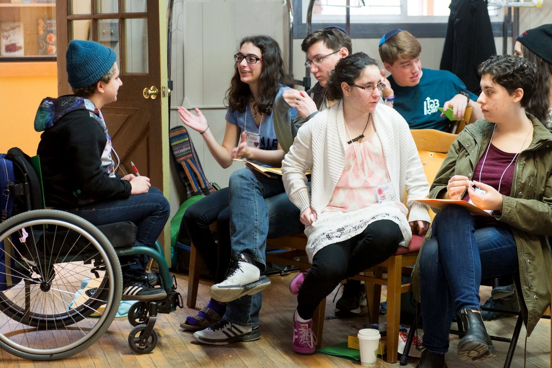
Keshet works for the full equality of all LGBTQ Jews and our families in Jewish life. We strengthen Jewish communities. We equip Jewish organizations with the skills and knowledge to build LGBTQ-affirming communities, create spaces in which all queer Jewish youth feel seen and valued, and advance LGBTQ rights nationwide.
Notes:
Trainer introduce themselves. Keshet was founded in 1996 in Boston as a volunteer-led organization. We are now a national organization with offices in Boston, New York, Chicago, and San Francisco.
Three main areas of work: Education & Training, Youth Programming, and Community Mobilization.

Slide 3
Goals
By the end of this training, you will be able to:
Understand the current landscape facing LGBTQ+ youth
Understand the positive impact of representation, LGBTQ+ inclusive curriculum, and affirmation for LGBTQ+ learners
Identify tools and resources for Celebrating LGBTQ+ identities throughout the curriculum

Slide 4
Kavvanot - Intentions
Growth and Learning Mindset
Take Space/Make Space
Take Lessons, Leave Stories
Trust Intent, Tend Impact
Prepare for Non-closure
Have Fun!
Notes:
Growth and Learning Mindset – we all have the ability to ask questions without being judged for what we already know.
Take Space/Make Space – invite participants to notice how much “airtime” they are using, and adjust so that they and others all have space.
Take Lessons, Leave Stories – if sharing beyond this group, please do not include any identifiable details without explicit permission.
Trust Intent, Tend Impact – Acknowledge the good intentions of people for being in this training. Also acknowledge that by virtue of being different human beings, we cannot always predict the impact our words might have on others. If something said here feels hurtful or uncomfortable to you, please say something so that the person who said it can tend to it. If someone shares that your words landed painfully to them, please do not take that as an attack, but as an invitation to tend to the relationship.
Prepare for Non-Closure – We will learn a lot together today! And we cannot learn everything that there is to learn in the time we have together, please assume that there will still be more to learn!
Stay Present as Much As Possible – Acknowledge that we are all entering this space with different things going on. Tend to what you need to, and do what you can to stay present.
Have Fun!

Slide 5
The “Why”
Notes:
Frame this work in why it is important and needed from a Jewish perspective.

Slide 6
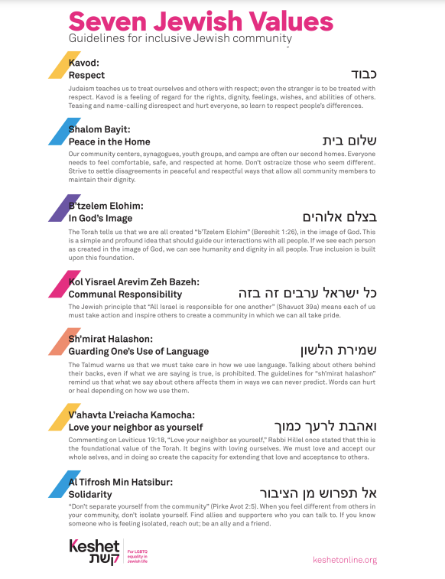

Slide 7
Journal/Reflect:
Do any of those values show up directly or indirectly in your school’s mission, vision, or values statements?
How might LGBTQ+ belonging already align with your core values?
Notes:
In small groups of breakout rooms. Provide each group with a copy of the 7 values handout OR access to a copy of the JAMboard for this session.

Slide 8
Understanding the Current Landscape

Slide 9
Brainstorm
What do you need in order to feel ready to learn?
Consider
Physical Tools / Environment
Psychological Environment
Framing or Context
Relationships
Notes:
Learning from our stories, real implications for action.
We are going to talk a lot today about how norms get constructed and communicated, and the impact that norms and assumptions have. I want you to carry this framework through the day, and think about what it would mean to build communities with the assumption that the “norm” is individuality and uniqueness.

Slide 10
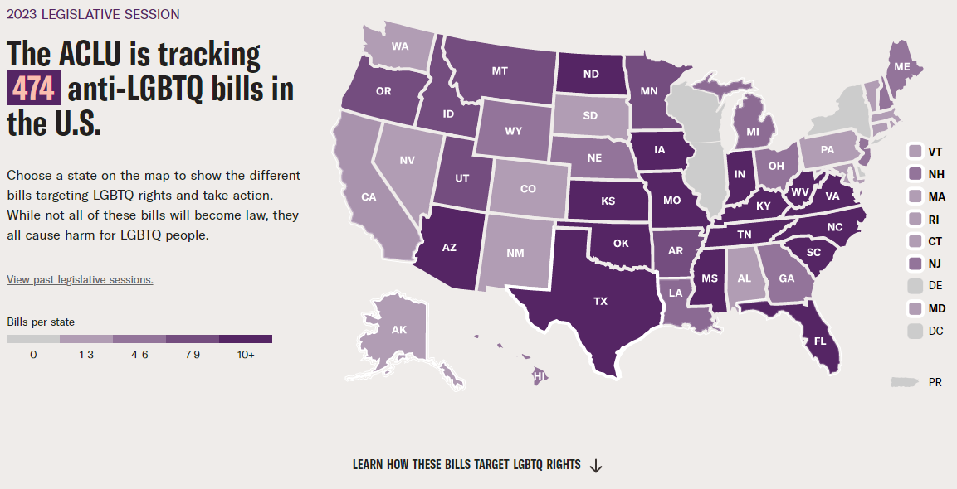
Current State of LGBTQ+ Rights
Notes:
Just jump towards the states that aren’t legal. It is surprising that this exists in 2023

Slide 11
LGBTQ+ Youth
Polls show roughly 20% of Gen Z and 22.5% of youth (ages 13-18) self-identify as LGBTQ+
1 in 3 LGBTQ+ Youth report they have been physically threatened or harmed in their lifetime due to their sexual orientation or gender identity
29% of LGBTQ+ youth have experienced homelessness, been kicked out, or run away
6 out of 10 LGBTQ+ youth said that someone attempted to convince them to change their sexual orientation or gender identity
45% of LGBTQ youth (including over half of transgender and nonbinary youth) seriously considered attempting suicide in the past year.
Data from The Trevor Project’s National Survey on LGBTQ Mental Health (2022), The CDC’s 2022 Adolescent Behaviors and Experiences Survey, Gallup polling, and GLSEN’s School Climate Survey
Notes:
From The Trevor Project’s National Survey on LGBTQ Mental Health 2020 – this just came out a few weeks ago!

Slide 12
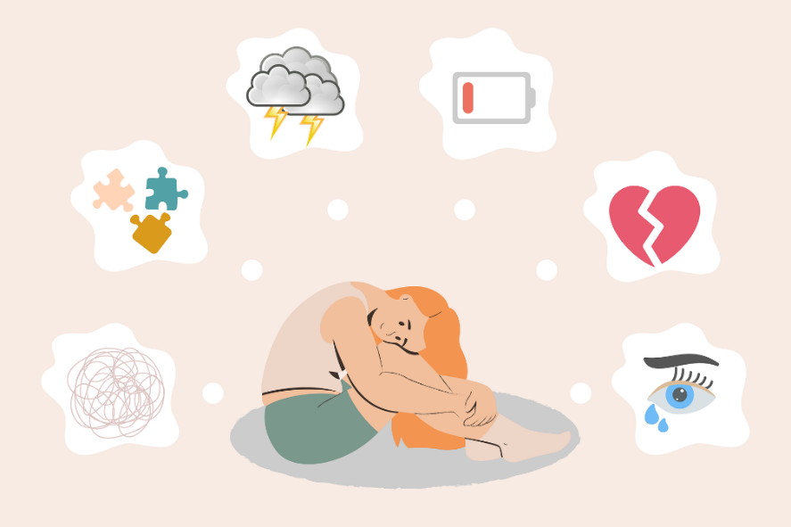
LGBTQ+ Youth and Mental Health
LGBTQ+ youth [and adults] “are not inherently prone to mental health challenges and suicide risk because of their sexual orientation or gender identity,” Dr. DeChants says. “Rather, they are often placed at higher risk because of how they are mistreated and stigmatized in society.”
“Intolerance Weighs Heavily on the Mental Health of the LGBTQ+ Community” By Robert DiGiacomo and Medically Reviewed by Adam Lake MD

Slide 13
LGBTQ+ Youth Mental Health
In a 2021 study, LGBQ youth reported “poor mental health” at twice the rate of heterosexual youth (64 vs 30%)
In a 2022 study, transgender and nonbinary youth reported even higher rates - as high as 79% for some groups
60% of LGBTQ+ youth who sought mental health care were unable to access it
LGBTQ+ youth of color, youth who have experiences violence or discrimination, and those whose homes or schools are not supportive are at highest risk of suicide
Data from The Trevor Project’s National Survey on LGBTQ Mental Health (2022), The CDC’s 2022 Adolescent Behaviors and Experiences Survey

Slide 14
LGBTQ+ Youth Mental Health
Just over 30% of LGBTQ+ youth report that home is an affirming space, just over 50% report that school is an affirming space
Top five supportive parental actions reported by youth:
Welcoming LGBTQ+ friends/partners,
Speaking respectfully about LGBTQ+ identities,
Using correct name and pronouns,
Supporting gender expression,
Educating selves about LGBTQ+ issues
89% of LGBTQ+ youth reported that representation in TV/movies/media helps them feel good about being LGBTQ+
Data from The Trevor Project’s National Survey on LGBTQ Mental Health (2022), The CDC’s 2022 Adolescent Behaviors and Experiences Survey

Slide 15
In School
77% of trans and nonbinary students K-12 report mistreatment in school, including bullying, harassment, assault.
17% reported this was severe enough they left school for safety reasons.
Only 56% reported incidents to staff, of those 50% reported that the staff took no action or told them to ignore it.
More than 25% prevented from using restrooms, locker rooms, or facilities aligning with their gender.
Across ALL stats, LGBTQ+ youth who are also BIPOC report dramatically higher rates of mistreatment than White LGBTQ+ youth, including both higher rates of anti-LGBTQ+ bias and higher rates of racist bias.
https://www.glsen.org/research/2019-national-school-climate-survey
https://www.ustranssurvey.org/
Notes:
Idit

Slide 16
Our communal responsibility:
Working for systemic change
Building affirming communities
Promoting and honoring resilience

Slide 17
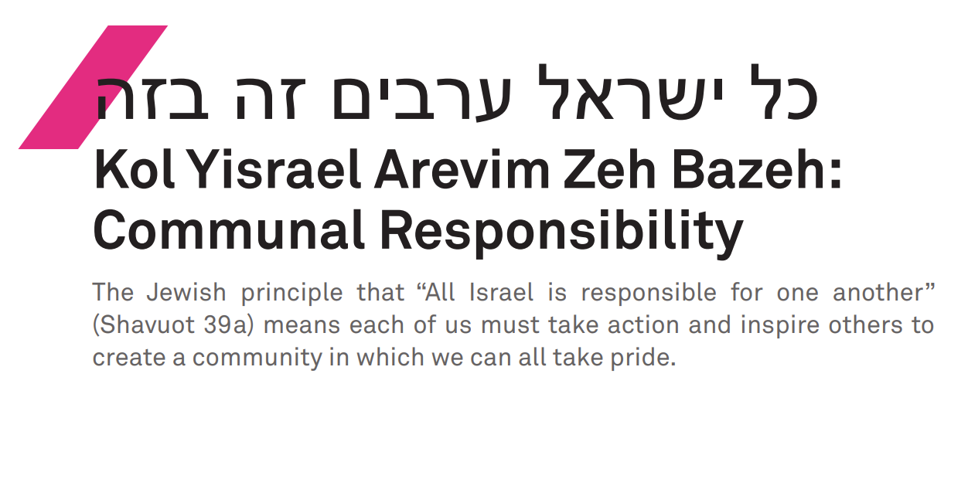

Slide 18
Three Domains for Organizational Change

Slide 19
Content
Policy
Culture

Slide 20
Content
Curriculum
Representation
Sex and Health Ed
Affinity Spaces
Hebrew

Slide 21
Curriculum
History is important for everyone, but it takes on a special importance when evidence of one’s very existence has been manipulated and censored, forgotten, buried, and destroyed. This is particularly true for queer Jews and others with doubly- or multiply-marginalized identities who so often must fight for recognition and legitimacy on many fronts, both inside and outside the various communities to which they belong.
Noam Sienna, A Rainbow Thread p. 3

Slide 22
Talking About Identity & Values

Slide 23
Curriculum

Slide 24
Keshet Resources on JEP Portal
Lesson Plans
Educator/Employer Tools
Texts
Etc

Slide 25
Representation: Assessing for Quality Media
Is this own-voices media?
When/where is it set? Does the setting require any context for students?
How has this media been received in the LGBTQ community?
Do LGBTQ characters in this media have full and complex characters? Story arcs that go beyond encountering obstacles as LGBTQ people?
What happens to LGBTQ characters in this media? Do they find fulfilment / connection / etc.?

Slide 26
Hebrew/Ritual Language
Kehilathadar.org
NonbinaryHebrew.com

Slide 27
Affinity Spaces
GSA/QSA space: correlated with increased sense of safety and support among students.
Student leadership
Assessing need

Slide 28
Building Culture of Feedback
“Always getting it right” versus “always learning and responding”
Actively seeking – and responding to - honest feedback
Building trust

Slide 29
Questions and Conversation
Notes:
Bring back the questions from the “parking lot,” working with the group to identify which are most relevant for them to discuss in real-time and which can be addressed through follow-up resources or one-to-one conversation.

Slide 30
Recap
Understand the current landscape facing LGBTQ+ youth
Understand the positive impact of representation, LGBTQ+ inclusive curriculum, and affirmation for LGBTQ+ learners
Identify tools and resources for Celebrating LGBTQ+ identities throughout the curriculum
Notes:
Tie back together the material you have covered, remind the group what you have come here to learn today.

Slide 31
Share Back
One thing that you are taking away with:
your head (something that you learned)
your heart (something that you feel)
or your hands (something that you can do).
Notes:
Tie back together the material you have covered, remind the group what you have come here to learn today.

Slide 32
לא עליך המלאכה לגמור, ולא אתה בן חורין ליבטל ממנה.
Lo aleikha ham’lakha ligmor, velo atah ben khorin lehibatel mimenah.
It is not upon you to complete the work, but you are not free to desist from it.
- Pirkei Avot 2:16
Notes:
Close with the note that this conversation was just the beginning – 90 minutes can only just scratch the surface. Encourage questions, further learning, and continued work.
Also note this approach to institutional change work – it is most successful when done in realistic, achievable chunks that take into account current resources and capacity. Over time, this work can be sustained and can grow!
(context for this quote, if asked)
Pirkei Avot (pronounced peer-KAY ah-VOT) is a collection of Jewish wisdom literature that was composed in Israel between 190 – 230 CE. The title translates literally to “chapters of the fathers / chapters of the ancestors,” and is sometimes called in English “Ethics of the Ancestors.”
This quote (said by Rabbi Tarfon, a prominent sage who lived in Israel in the first century CE), is a great way to close a training and frame a call to action: we believe that learning and institutional change are ongoing. The intention is not to leave this space feeling overwhelmed by the number of things that we could do, but to approach the work with the intention of working sustainably and being committed for the long haul.

