Slide 1



Queering Jewish End of Life Planning
Notes:
Welcome.
Trainers who choose to make a brief land acknowledgement should do so as part of their introduction.
Quick lighthearted prompt in the chat or with your neighbors.
Introduce any relevant logistics – how and when to get trainer’s attention for questions, whether questions should be asked as they come up or at section breaks / Q&A at the end, whether trainer will or will not be following the chat if online, etc.

Slide 2
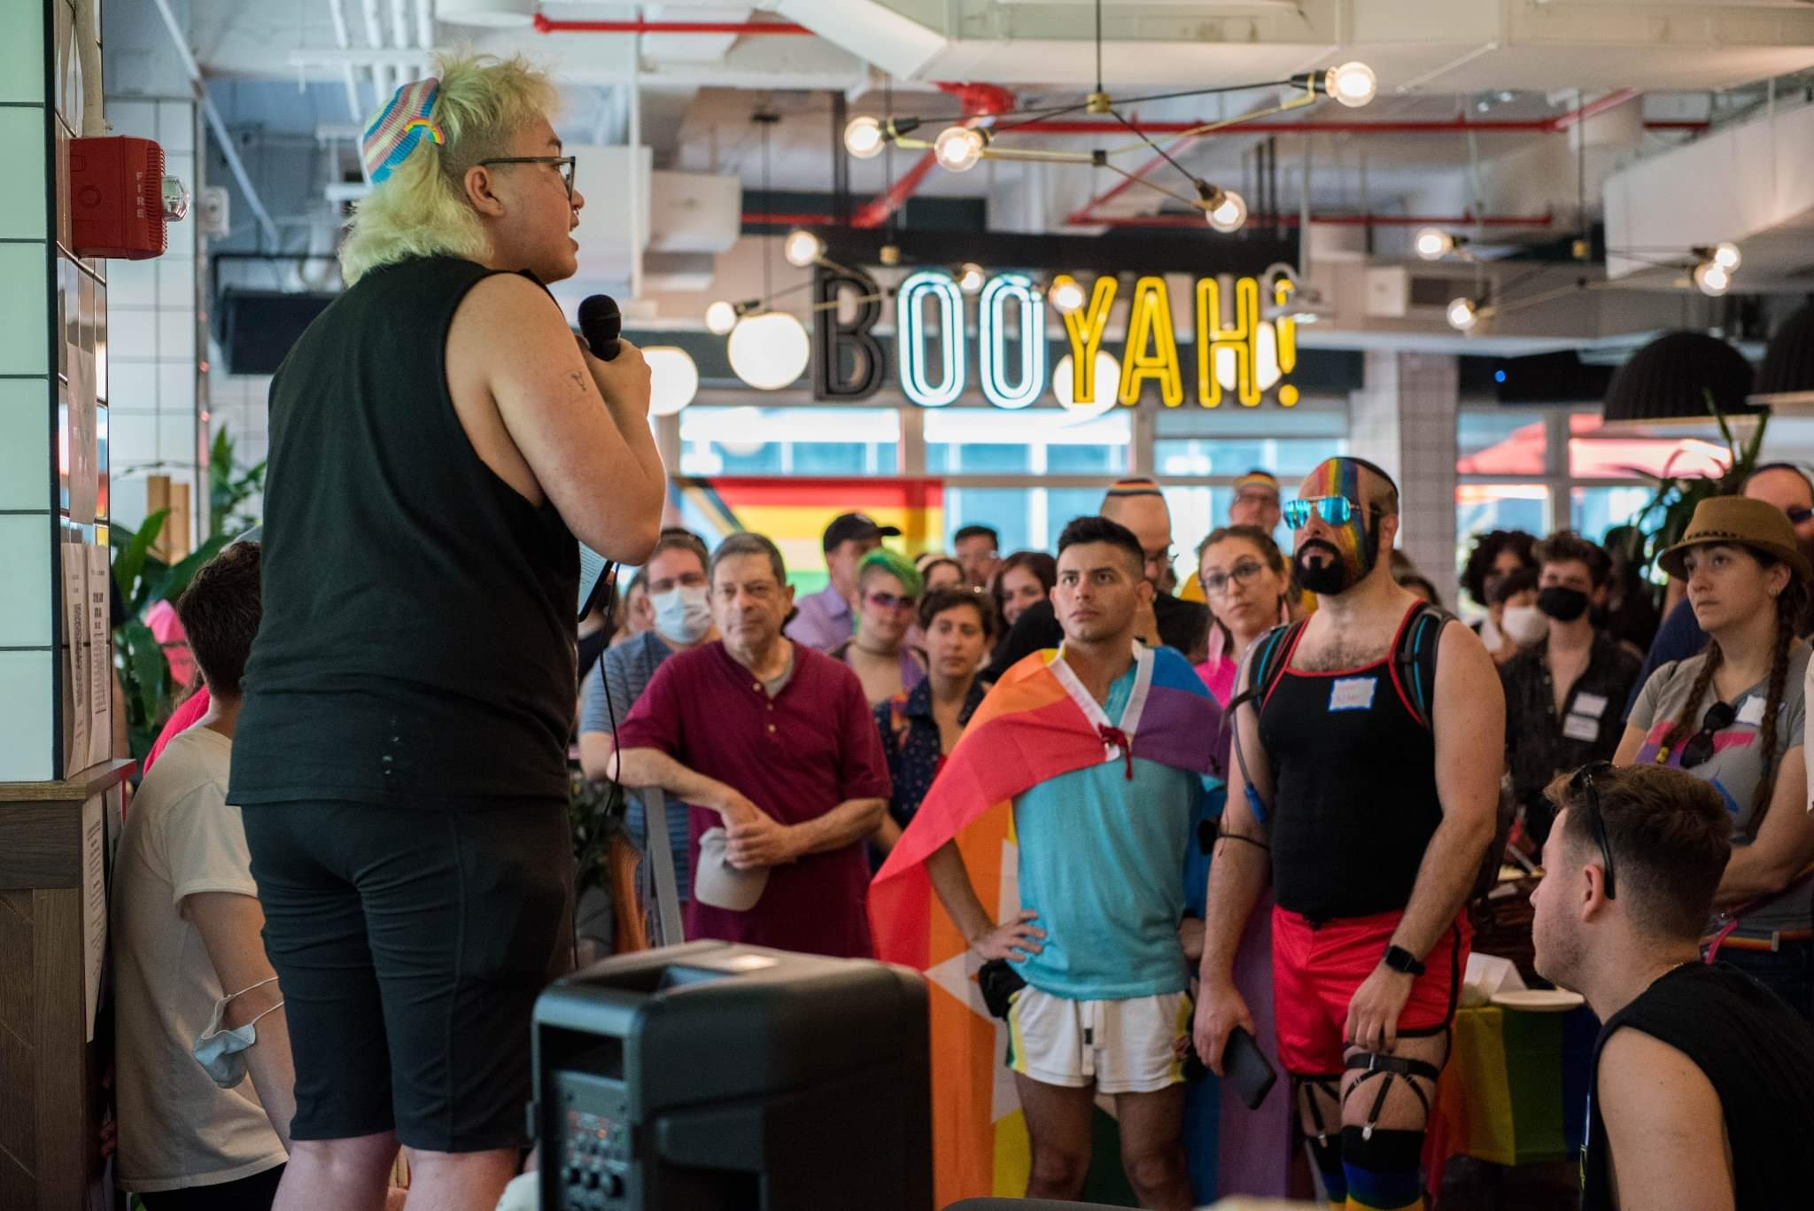

Keshet works for the full equality
of all LGBTQ Jews and our families in Jewish life. We strengthen Jewish communities. We equip Jewish organizations with the skills and knowledge to build LGBTQ-affirming communities, create spaces in which all queer Jewish youth feel seen and valued, and advance LGBTQ rights nationwide.
Notes:
Trainer introduce themselves. Keshet was founded in 1996 in Boston as a volunteer-led organization. We are now a national organization with offices in Boston, New York, Chicago, and San Francisco.
Introduce Keshet’s mission, and mention our four program areas: Education & Training, Youth Programming, LGBTQ+ Jews of Color, and Community Mobilization.

Slide 3

Shomer Collective works to improve end of life experiences by helping people to talk more openly about death, dying, and mourning, through the lens of Jewish wisdom and Jewish practices. We provide resources, educational programming, and opportunities to connect for educators, clergy, end-of-life professionals, individuals, families, and organizations who are interested in exploring the rich intersection between Jewish life and death.
For more Jewish wisdom and resources on death and dying, please visit: www.shomercollective.org
Notes:
The resources in this collection were created as part of the Shomer Collective Educator Fellowship, a 9-month, online, cohort-based learning experience for Jewish educators from a variety of settings and backgrounds. The fellowship is a learning community and an innovation lab; fellows learn to integrate Jewish wisdom about life and death into their work, and develop resources to bring conversations about end-of-life issues into Jewish educational spaces. The Shomer Collective Educator Fellowship was made possible through the generous support of the Covenant Foundation.

Slide 4

Goals
By the end of this training, you will be able to:
Make connections between living an LGBTQ+ life and planning for an LGBTQ+ death.
Identify frameworks and language tools for building towards LGBTQ+ equality and belonging in EOL planning.
Make connections between Jewish values and EOL planning.

Slide 5
Kavvanot - Intentions
Growth and Learning Mindset
Take Space/Make Space
Take Lessons, Leave Stories
Trust Intent, Tend Impact
Prepare for Non-closure
Stay present (as much as possible!)
Have Fun!
Notes:
Growth and Learning Mindset – we all have the ability to ask questions without being judged for what we already know.
Take Space/Make Space – invite participants to notice how much “airtime” they are using, and adjust so that they and others all have space.
Take Lessons, Leave Stories – if sharing beyond this group, please do not include any identifiable details without explicit permission.
Trust Intent, Tend Impact – Acknowledge the good intentions of people for being in this training. Also acknowledge that by virtue of being different human beings, we cannot always predict the impact our words might have on others. If something said here feels hurtful or uncomfortable to you, please say something so that the person who said it can tend to it. If someone shares that your words landed painfully to them, please do not take that as an attack, but as an invitation to tend to the relationship.
Prepare for Non-Closure – We will learn a lot together today! And we cannot learn everything that there is to learn in the time we have together, please assume that there will still be more to learn!
Stay Present as Much As Possible – Acknowledge that we are all entering this space with different things going on. Tend to what you need to, and do what you can to stay present.
Have Fun!

Slide 6
Think / Pair / Share
Think of a part of your identity that you would like others to celebrate after your death.
It could be anything, like being a great parent or soccer player or your nationality
What are the ways in which others can celebrate this part of you?
Share with a partner – you will each have three minutes.

Slide 7
What I mean by EOL Planning
1) contemplating and planning for our deaths in ways that enable us to articulate our wants, needs, and what matters to us
2) having conversations with important people in our lives to help ensure that our wants and needs are known and respected; and
3) doing the necessary paperwork to help document our wishes and protect us and those we care about.
Notes:
The phrase “end-of-life planning” means different things to different people, and can encompass a lot. In the context of this session I’m talking about three things:
Many of the health professionals and other care providers we might interact with at end of life lack knowledge and training about sexuality and intimacy, and what they do know might not align with or encompass the diverse identities, relationship structures or needs and desires of the LGBTQ2S+ people in their care.

Slide 8
What’s Jewish About This Work?
“Beloved is humanity, that we are made in G-d’s image” - Pirkei Avot 3:14
Source of kindness and compassion… Help us to see your face in the face of the deceased, even as we see you in the faces of those who share this task with us. Source of Life and death, be with us now and forever.
Notes:
We often talk about the holy nature of being formed in the image of G!d- and how that contributes to the reality that every person, especially all LGBTQ+ people, are deserving of dignity
whose ways are ways of mercy and truth, you have commanded us to act with lovingkindness and righteousness towards the dead, and to engage in their proper burial. Grant us the courage and strength to properly perform this work, this holy task of cleaning and washing the body, dressing the dead in shrouds, and burying the deceased. Guide our hands and hearts as we do this work, and enable us to lovingly fulfill this commandment.
When talking about being made in G!d’s image, how does that impact the ways we think about the dead and dying? This is an except from the text that my hevra kaddisha recites before we begin tahara. How does rooting our work, both in preparing for and in the burial itself, in seeing the face of g!D in the face of the dead guide the ways in which we should approach this work?

Slide 9
What it means to age as an LGBTQ+ individual

Slide 10
There are around 3 million LGBTQ+ adults over age 50
LGBTQ+ older adults are:
2X as likely to be single and live alone
4X less likely to have children
More likely to face poverty and homelessness
Many LGBT people have reported delaying or avoiding necessary medical care because they fear discrimination or mistreatment by health care staff.
SAGE USA, May 2022
Notes:
although the census doesnt measure for LGBTQ+ folks, That number is expected to grow to around 7 million by 2030.
Nearly 1 in 4 transgender people report having to teach their health care provider about transgender issues in order to receive appropriate care, and 15% report being asked invasive or unnecessary questions unrelated to the health care they are seeking at the time.16 88 percent of LGBT older people say they would feel more comfortable with long-term care services if they knew staff had been specifically trained about the needs of LGBT patients. More than two thirds say this would make them feel much more comfortable.

Slide 11
Honoring LGBTQ+ Elders
LGBTQ+ older people are living vibrant, full lives throughout every part of the country and around the world.
They were the pioneers who stood up and pushed back at the Stonewall uprising, and the caregivers who stood by friends and loved ones through the height of the AIDS epidemic.
So how can we honor them in death and uphold the value of Kavod HaMet?
Notes:
They are models of resilience, celebrating their identities while persevering through adversity and helping to bring about incredible change for all LGBT people over just a few short decades.
AND they aren’t always out or they may have gone back in the closet in care situations

Slide 12
So what’s different about dying as a LGBTQ+ person?

Slide 13
To be queer means we often exist in intimate proximity to death.
When we queer death, dying and mourning, they become sites of creativity, self-determination, and collective care
This practice creates opportunities to challenge dominant ideas and narratives that limit our ability to express who we are in life and in death
Notes:
Surviving each day in a world that wishes you dead demands charisma, uniqueness, nerve, and talent.
Queerness offers us ways of perceiving and being in the world around us while making and remaking it through a distinctly queer lens.
LGBTQ+ people are among the many communities who know what it’s like to live and die in a context of laws, policies, institutions and systems not designed for us, or that are intentionally designed to exclude or eradicate us or prevent us from forming families.
While the conditions of LGBTQ+ people’s lives often push us into unwanted proximity with death, we have the power to reimagine how we die and how we mourn. This includes active resistance to the violence and oppression that cuts short too many LGBTQ+ people’s lives and an invitation to subvert the beliefs and practices getting in the way of dying queerly, on our own terms.

Slide 14
Situating Ourselves in a Larger History
LGBTQ+ people have been forever creating ritual and prayer to speak to our experiences on the fringes
In the 1980s, Rabbis and Spiritual leaders (like Debbie Friedman) composed prayers and and new forms of Jewish healing rituals to meet the AIDS crisis.
Notes:
GIven these histories, especially in the Jewish world, there is so much opportunity to build upon tradition and create new ritual and liturgy that speak to the unique experience of LGBTQ+ death and dying
living funeral (emet/shatzi) / party

Slide 15
Who makes decisions about how we die and are remembered?
In the absence of us naming our decision-makers and sharing our wishes in advance, the state typically defaults to whoever it deems our legally recognized family to be.
This is complicated for everyone, especially for LGBTQ+ people!
Notes:
This is the case for medical care/ decision making, as well as decisions about burial/ritual and funeral
It might be crucial to do everything in your power to prevent the family you were born or adopted into from having any say in what happens to you at the end of your life. This is often a concern for LGBTQ+ people who are estranged from their families and for trans and non-binary people who need safeguards in place to ensure their gender identities are respected in the context of their end-of-life and funeral care.
For members of the LGBTQ community, dying without the legal protections of a living will or power of attorney could mean spending their final days without the support of the people who love them or being remembered in a funeral or memorial service in ways they wouldn’t have chosen to (by a deadname or old gender)
Before same-sex marriage was legal, there were horror stories about families swooping in and making medical decisions that didn’t accord with people’s wishes.
Historically, death for members of the LGBTQ community has signaled the beginning of a process of suppression of the fact that they were queer. This has played out in several ways, only one of which is restrictive cemetery regulations. Other times it’s the doing of disapproving family members.
Gravestones aren’t the only place where memorialization has historically been a vehicle for erasure. Written tributes of LGBTQ people have all too often included a lot of tiptoeing around the decedent’s sexual orientation. The not-so-secret code phrase for gay men of “lifelong bachelor” still stubbornly shows up on a few dozen paid death notices every year.

Slide 16
What can we do to change that?
Encourage people to fill out living wills, to make their wishes around funerals and burial known, especially when they are doing well.
Model filling out those forms yourself!
Notes:
Talking about forms, what language do your forms use? Note that many of the ways that English speakers communicate include gender in ways that we do not think of. From greetings to common expressions, gender – and assumptions about gender – are frequently present. Try to use language that does not make assumptions!
How often do we make assumptions about partners in a person’s life? And what sort of signal of safety (or not) does that give to the person we’re talking to?

Slide 17
“I approach end-of-life planning as a form of self-protection. It’s a way of defining who is family to me and who I trust to make decisions on my behalf. It sure as hell isn’t the state or the people I’m related to by blood.”
- queer death doula
Notes:
A 2020 survey published in the Journal of Palliative Medicine found that nearly one-quarter of health care providers witnessed discrimination against LGBTQ patients in palliative care settings and nearly 30% of the respondents reported witnessing discrimination against LGBTQ spouses, partners, or people whom the patient had legally designated to make care decisions for them.

Slide 18
Toward a Gender Inclusive Hevra Kadisha
As a hevra kadisha, our number one guiding principle is kevod hameit- respect for the dead
Respecting the gender identity of those we serve – as they, not we, define it – is an essential part of that practice
https://www.keshetonline.org/wp-content/uploads/2020/03/Toward-a-Gender-Inclusive-Hevra-Kadisha-final-.pdf
Notes:
We know that as a hevra kadisha, we have an advantage over people in other contexts when it comes to matters of respect and honor. The tahara room as it exists already is a space of ultimate body positivity. There is no judgment about body size or shape, medical conditions and devices, the state of the skin or hair or lack thereof. Our task is fundamentally and crucially nonjudgmental in nature.
All people want to be treated with dignity, for trans people, the clearest expressions of that dignity include using their chosen name and pronouns.
In the case of tahara, dignity includes reassurance that members of the tahara team would not be surprised, shocked, curious, or otherwise caught off guard by their trans bodies.
Include non-binary hebrew for”tahara who” ????

Slide 19
Wrapping Up

Slide 20
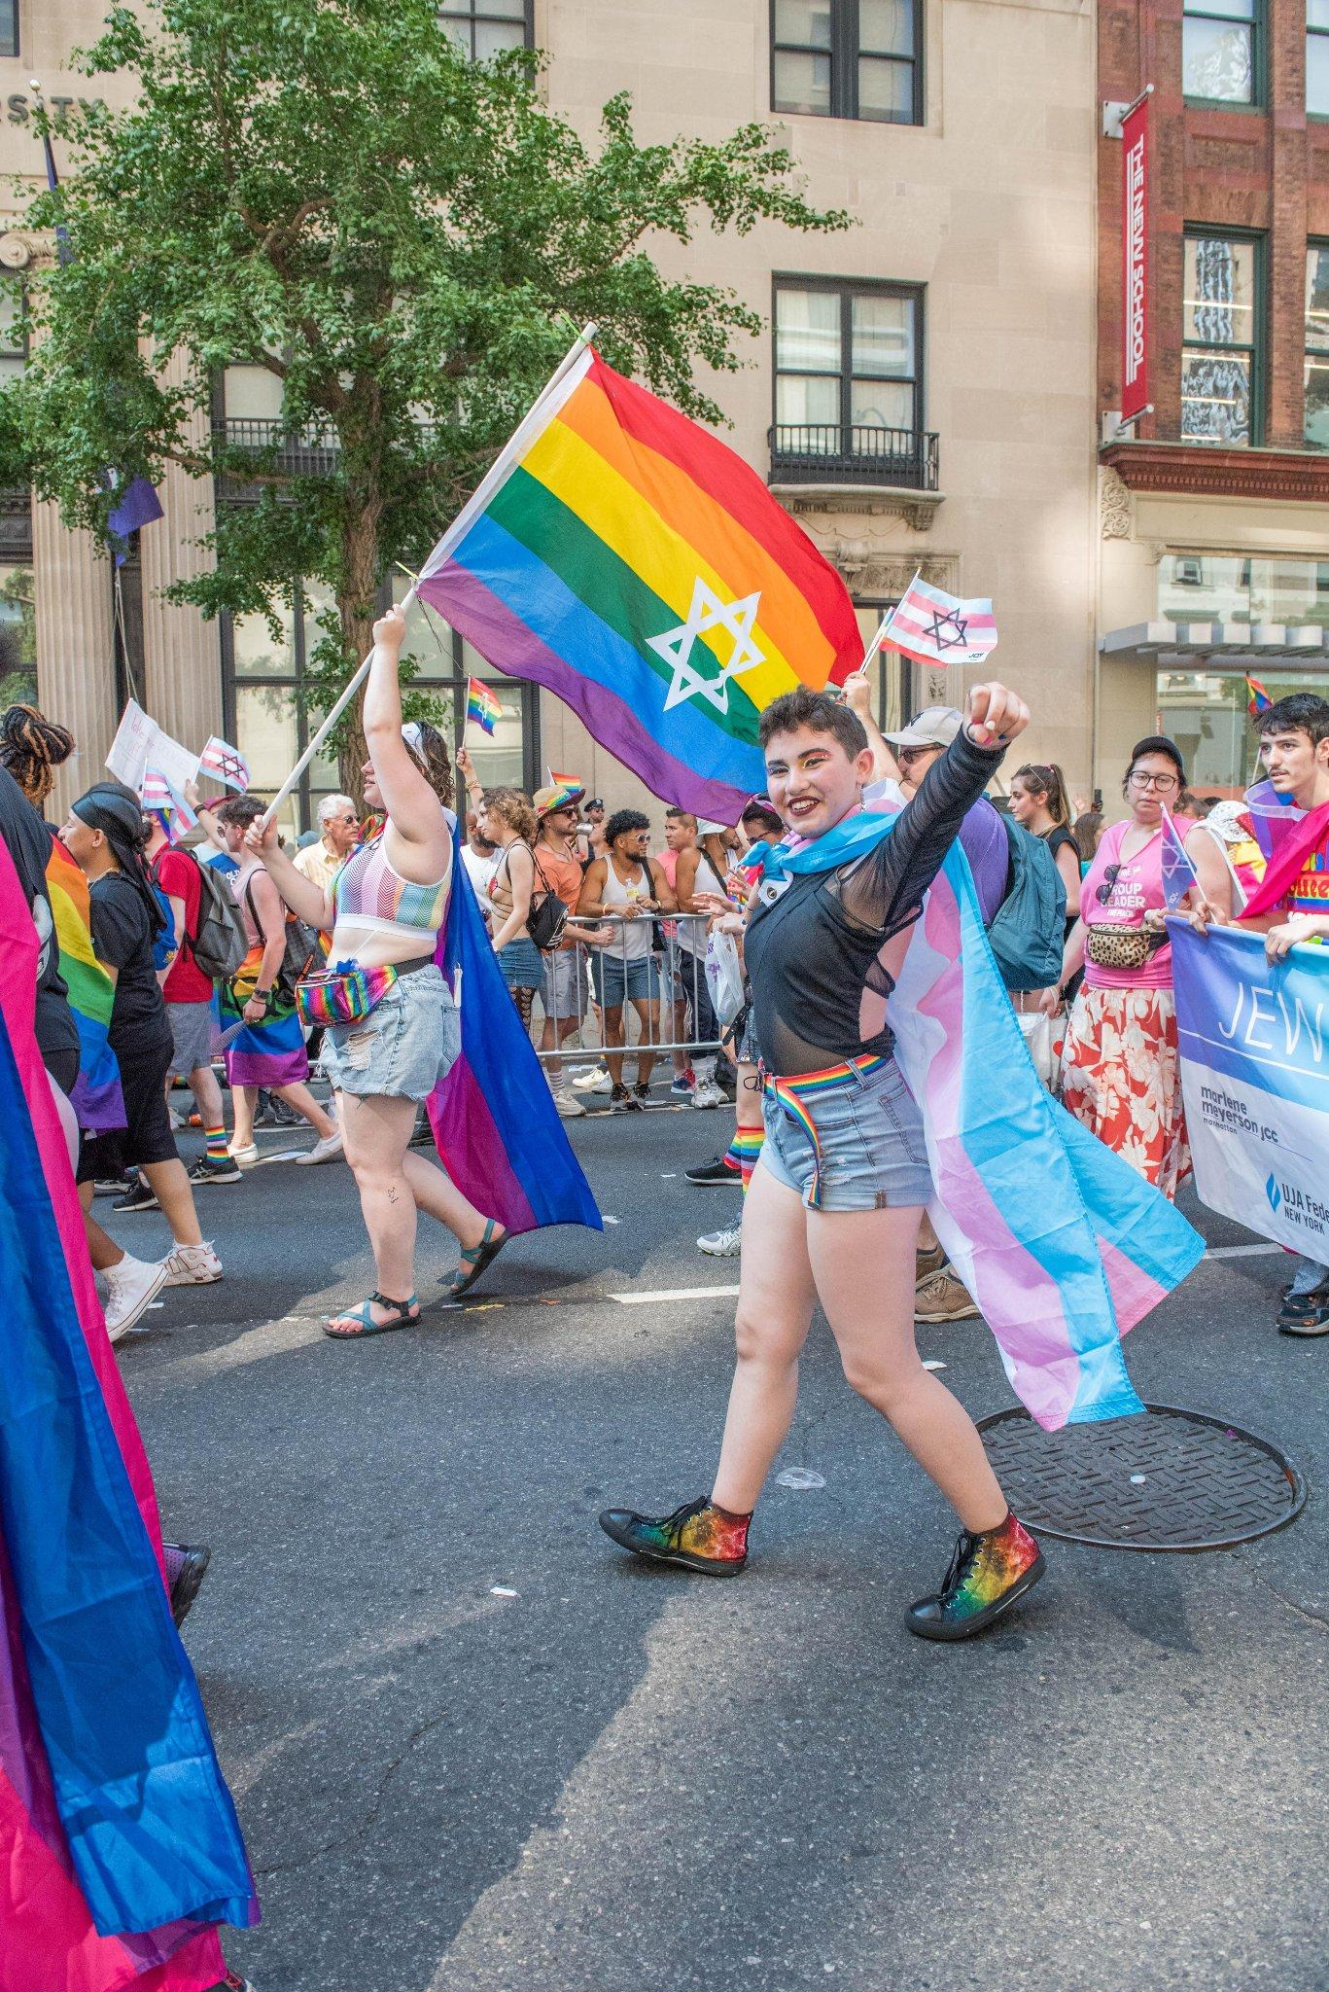
Working With vs
Working For
“If you have come here to help me you are wasting your time, but if you have come because your liberation is bound up with mine, then let us work together.”
― Lilla Watson
Notes:
Lilla Watson is an Indigenous Australian artist, activist, and academic in Queensland whose writings, political activity, and works of visual art explore epistemology, Aboriginal cultural heritage and knowledge.
Although she is widely quoted as having made this statement at a speech to the United Nations in 1985, she developed this idea and the phrasing as part of an Aboriginal rights group in Queensland in the 1970s.

Slide 21
Taharah
Miller Oberman
I’m wondering about you, chevra kadisha, the “holy society,” who will prepare my body, once I’m no longer in it, for the earth.
Notes:
Taharah- Miller Oberman
I’m wondering about you, chevra kadisha,
the “holy society,” who will prepare my body,
once I’m no longer in it, for the earth.
Will you know me already, or see me for the first time
as you wash and shroud me, as my father was washed
and dressed in simple white tachrichim, for those
about to stand before God. Perhaps by then I’ll know
if I believe in God. I like the democratic
nature of the shroud, an equalizing garment.
You may see a body that surprises you. You may not have seen
a man’s body like this one before you, which I hope is very old,
wrinkled, and (since I’m wishing) fit, muscled
as much as an old man can be. You’ll see scars.
Ragged dog bit forearm, elbow my father picked gravel
from over the sink, then flushed with foaming iodine,
and the long double horizons on my chest, which trunked my body
like a tree. If I am unexpected, let me not seem
grotesque to you, as I have to many people, perhaps
even my own parents, and others whose highest
kindness was to say nothing. Please let me return to dust
in peace, as the others did, and recite those beautiful psalms,
remembering, as you go about your holy ritual,
how frightening it is to be naked before another,
at the mercy of a stranger’s eyes, without even any breath.

Slide 22
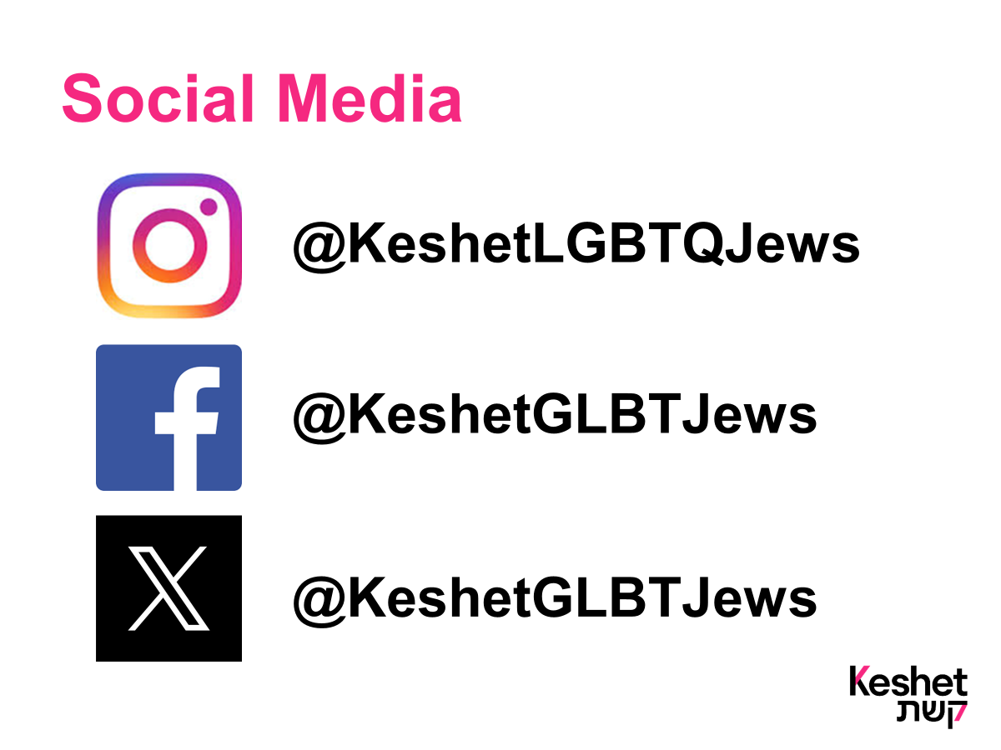

Slide 23

Thank you for joining us and stay in touch!
Email Keshet’s Education and Training Team at:
education@keshetonline.org

Slide 24
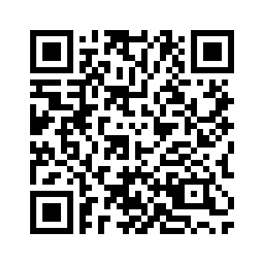
Feedback Survey
Notes:
Use this site: https://www.qr-code-generator.com/
https://keshet.tfaforms.net/849?id=701RP00000GnizbYAB
Then copy/paste the generated QR code image into the center of the slide

