Slide 1
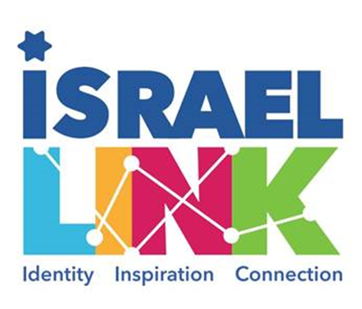

Slide 2

Jewish Resiliency in Difficult Times

Slide 3

What is happening in Israel right now?

Slide 4
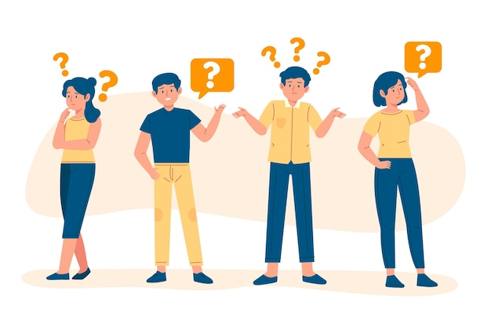
Do you feel personally affected by what is happening?

Slide 5
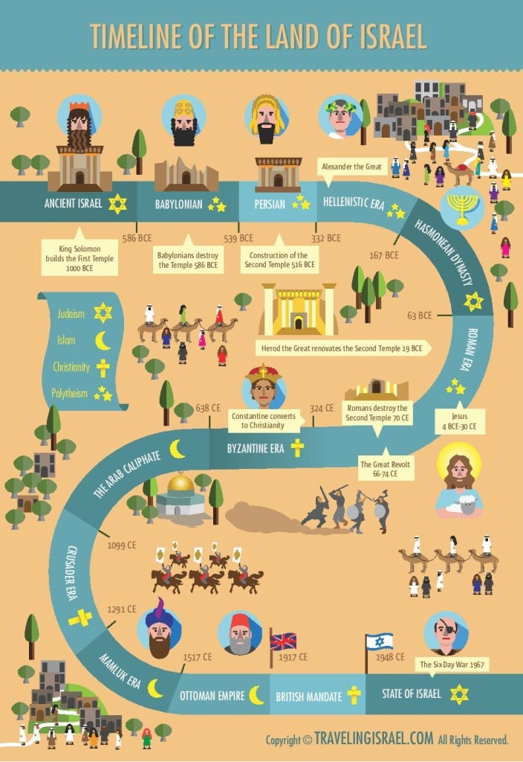
If you were to use one word to describe the history of the Jewish People, what would it be?

Slide 6
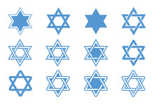
If you were to describe what matters most to you about being Jewish in one word, what would it be?

Slide 7
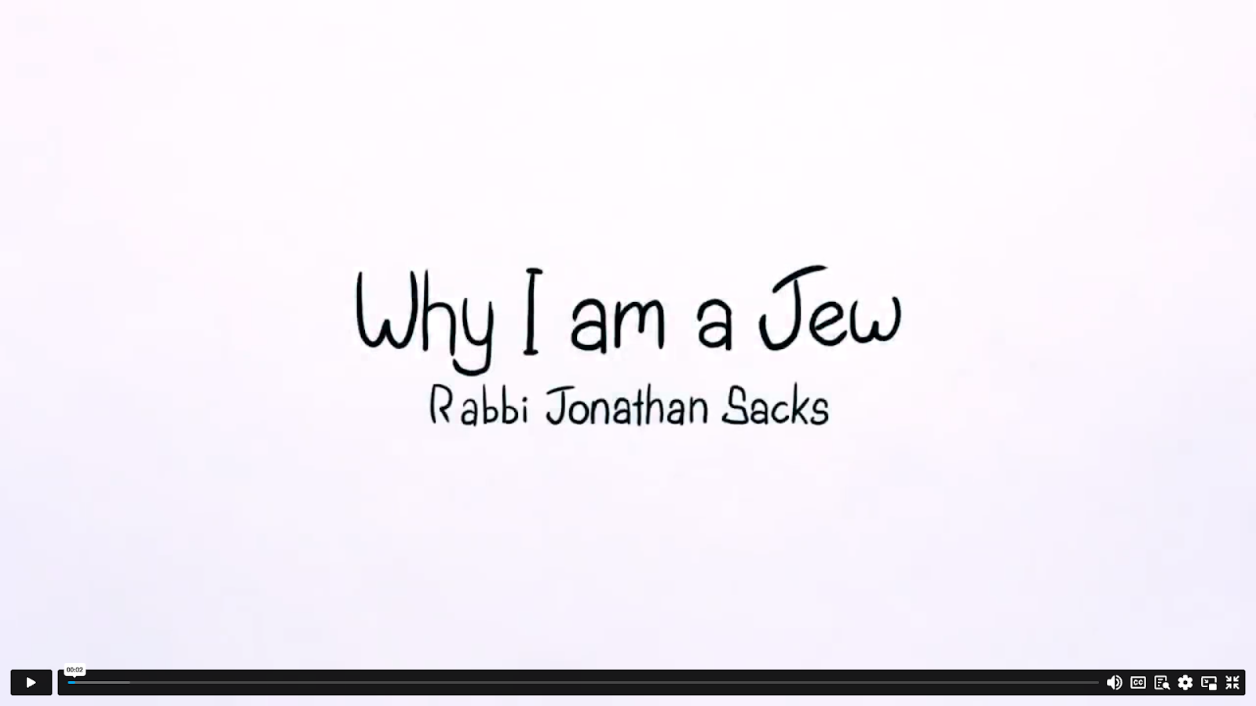

Slide 8

Based on the video you just saw; would you change any of your answers?
Why not?
Why?
What influenced you?

Slide 9
וְהִיא שֶׁעָמְדָה לַאֲבוֹתֵיֽנוּ וְלָנֽוּ. שֶׁלֹא אֶחָד בִּלְבָד, עָמַד עָלֵיֽנוּ לְכַלּוֹתֵנֽוּ. אֶלָּא שֶׁבְּכָל דּוֹר וָדוֹר, עוֹמְדִים עָלֵיֽנוּוֹתֵנֽוּ. וְהַקָּ לְכַלּדוֹשׁ בָּרוּךְ הוּא מַצִּילֵנוּ מִיָּדָם
Every Passover we read this in the Haggadah:

Slide 10
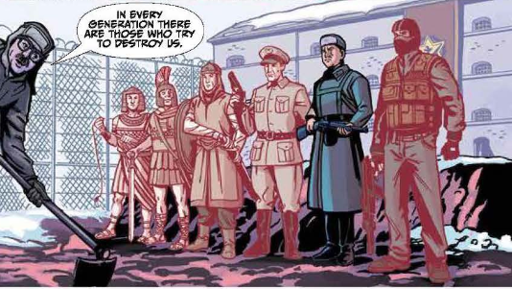
"And this (the promise to Abraham that the Jewish people would thrive) is what kept our ancestors and what keeps us surviving. For, not only one (Pharaoh) arose and tried to destroy us, rather in every generation they try to destroy us, and Hashem saves us from their hands. "

Slide 11
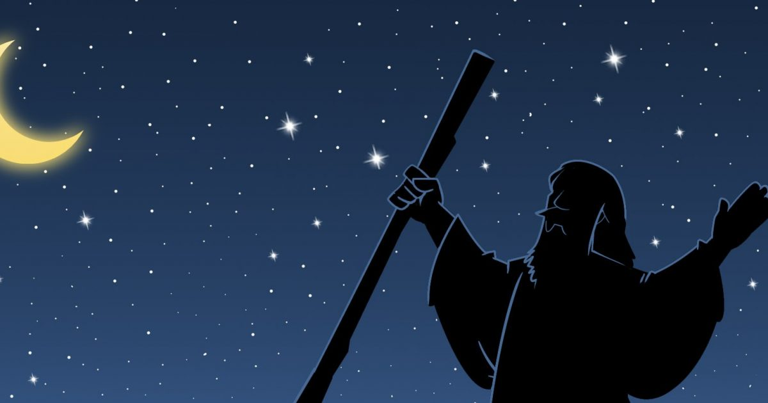

Vehi Sheamda tells the story of the Jewish people and their survival. In the translation, וְהִיא - vehi, refers to the promise between God and the Jewish people, saying that it is what has always kept the Jewish people alive.

Slide 12
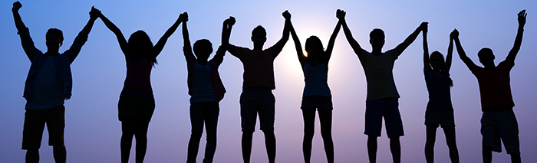
Instead of reading וְהִיא - vehi in reference to the promise, read it as you normally would: referring to the people who have עָמְדוּ - amdoo - stood for the nation of Israel - לַאֲבוֹתֵיֽנוּ וְלָנֽוּ - Lavoteinu v’Lanu - for our ancestors and us. This translation acts on the knowledge that the Jewish people are not sustained only by a word from God…

Slide 13
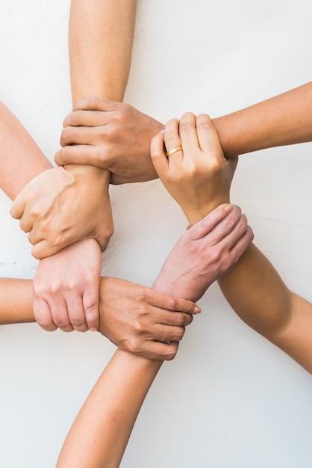
We are supported when we take action to support ourselves.
When the Jewish people are united, which is why the singular הִיא is used instead of the plural, it is because when we are UNITED, we are ONE. V’hee Sheamda acts as a reminder of strength and a call to action directed towards the Jewish people who until the State of Israel was declared, did not have the ability to defend themselves or others.

Slide 14

Examples of Heroism
We know that 300,000 reservist soldiers have been called up to duty. They are going into battle to ensure the people of Israel are safe and secure and that the terrorist group Hamas will never again be able to inflict pain and suffering on the Jewish people. But heroism and unity can manifest in many ways. Here are three examples of heroism and bravery that have emerged from the first days of the attack on Israel.

Slide 15
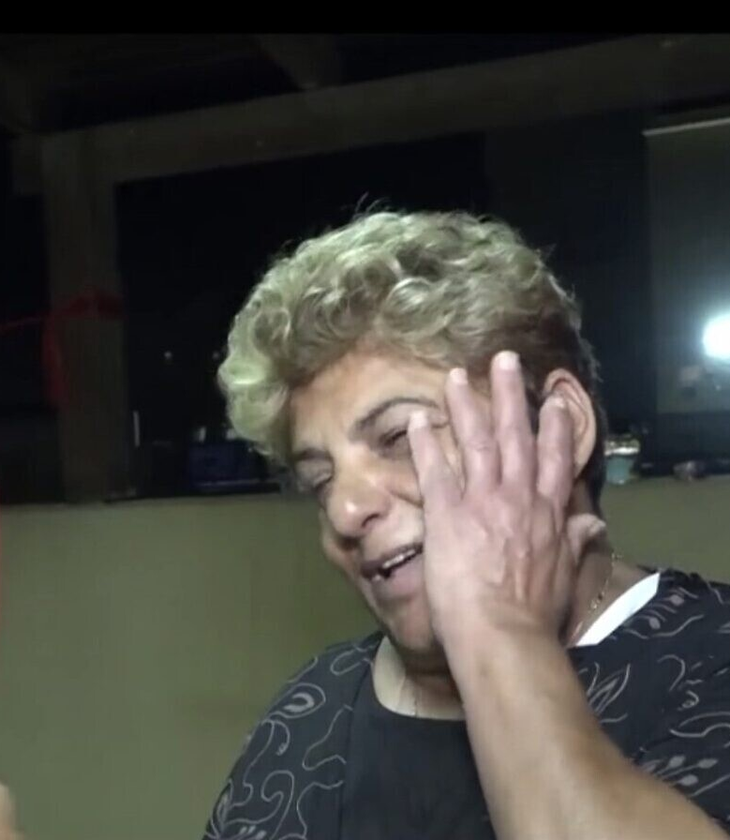
Rachel Edry
When Hamas terrorists invaded the home of Rachel Edry in Ofakim amid the brutal onslaught from the Gaza Strip on Saturday, she treated them in the way that came most naturally to her: politely.
The terrorists spent 15 hours until early Sunday morning in the home of Edry and her husband David, a couple in their seventies from Ofakim.
Even as they told her that she and her husband would become martyrs, Rachel Edry, who was born in Iran, served the terrorist treats, joked with them in rudimentary Arabic and even sang with them a Hebrew-language song by Lior Narkis they knew from the radio.
This semblance of hospitality may have saved the couple’s lives.
At 3 a.m. on Sunday, a police force broke into the duplex after hours of negotiations, killing all five terrorists and reuniting the couple, completely unharmed. Their daughter and two sons, both police officers, participated in the rescue operation.

Slide 16
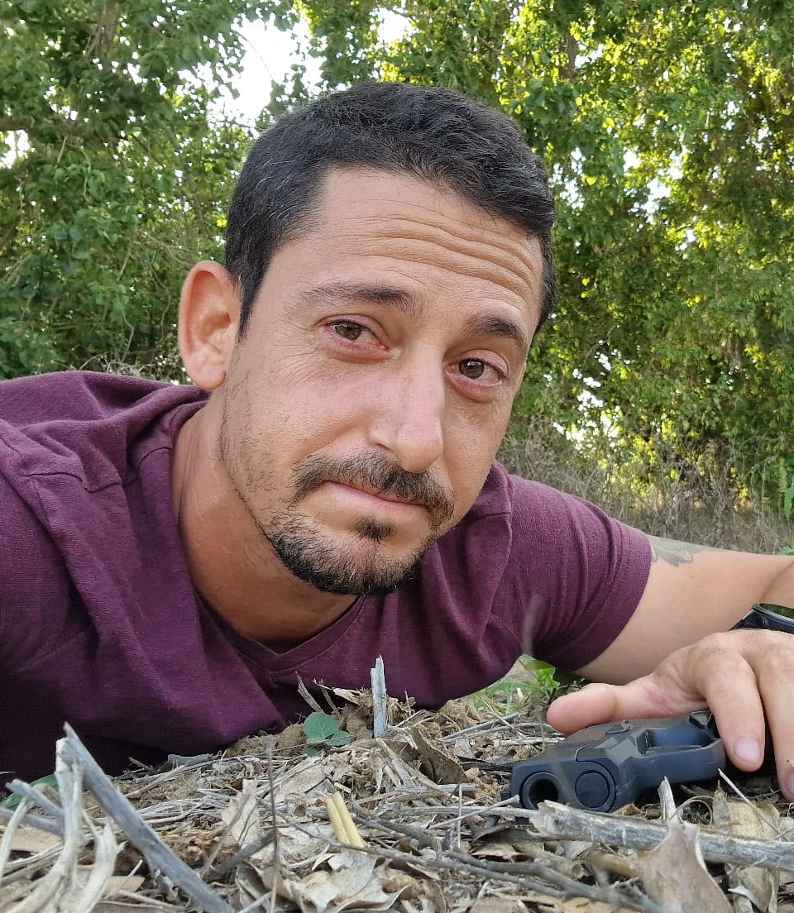
Noam Tibon
Noam Tibon is a reserves general from Tel Aviv. Within an hour of the terrorist incursion, he quickly assembled an intervention to rescue the residents of Kibbutz Nahal Oz where his son Amir lives.
Noam’s team neutralized several terrorists, including the terrorist that was outside Amir’s home where he, his wife and daughters were trapped.

Slide 17

Inbal Rabin-Lieberman
Inbal Rabin-Lieberman is the 25-year-old security coordinator of Kibbutz Nir Am. The kibbutz is on the Gaza border, so she’s heard lots of sounds, she realized that the sounds were different from those heard during the usual rocket attacks on the kibbutz. Over the objections of the higher-ups, who told her she was over-reacting, she unlocked the arms storage, gave guns to the kibbutz’ kitat konnenut (volunteer security team) and took charge. She placed her people in specific places around the kibbutz. When the terrorists arrived, this was the kibbutz that was ready. Over the course of a vicious gun battle that lasted hours, the armed civilians killed more than twenty-five attackers; Inbal, herself, killed five of them. Nir Am, where a 25 year old woman took charge, was the only kibbutz in the area without casualties.

Slide 18

When you read about V’ehi Sheamda you learned that it is not our enemies who define us but our unity.
There are many ways you can be heroic and brave. It is not always easy to put yourself at risk for others. There may be times over the next several weeks where it will be easier to just not respond. There may be times when you want to take the risk and respond to people who say things that are ugly, hurtful, false, or biased.
Remembering your “WHY” that you explored with the first activity of this lesson can help give you the courage to stand up for yourself. Only you can define your identity and what being a Jew means to you. Only you can determine how Israel fits into your Jewish identity and that, if it matters to you, nobody can tell you it doesn’t.

Slide 19
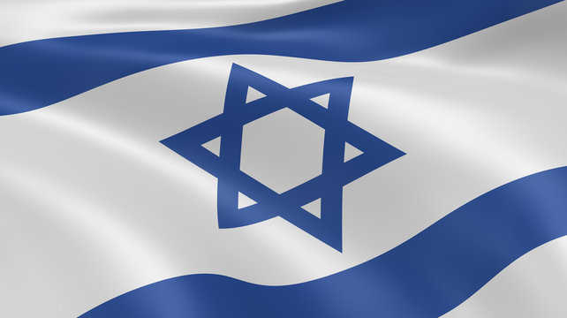
Your ancestors' journey here may have been from Iran, Morocco, Ukraine or Poland. They may have come here to start a new life of opportunity, or they may have arrived here fleeing horrors not unlike what Israel is experiencing. They brought different customs that dated back thousands of years. They may have chosen to join the Jewish people because it felt like home. Wherever your family’s history traces back to, it started long before that. In a tiny strip of land in the Middle East. Throughout the history of our people, it was called Cana’an, Judea, and Palestine. After the Romans exiled us from our Home, our 1900 years of wandering taught us that we would never be safe as long as we had to depend on others for our security. We would never be able to proudly express ourselves as Jews until we had the privilege of being a “Free People in Our Homeland.”

Slide 20
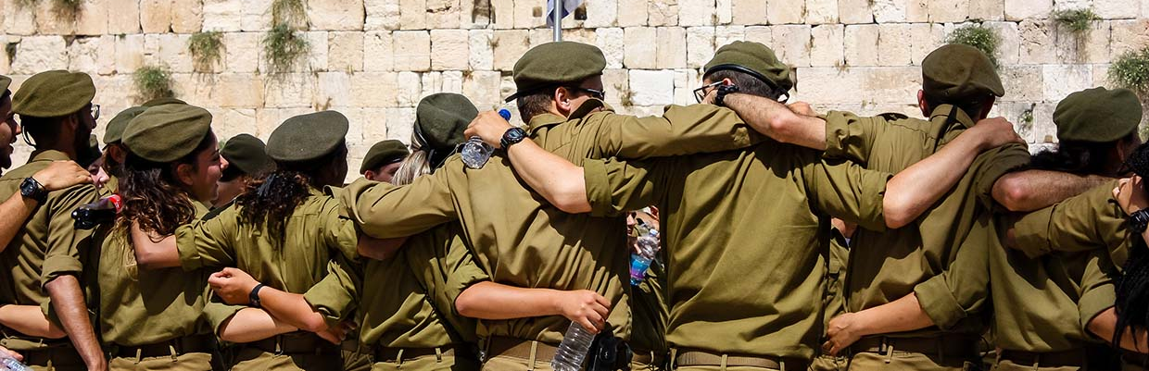
That is what Israel is to the Jewish people. Having our land, even if we don’t live there, means there will always be those who will put our safety first. That is what our soldiers are doing now.

Slide 21
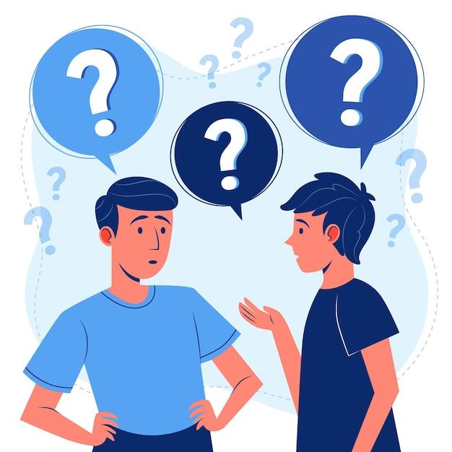
Are there any stories you would like to share?

Slide 22
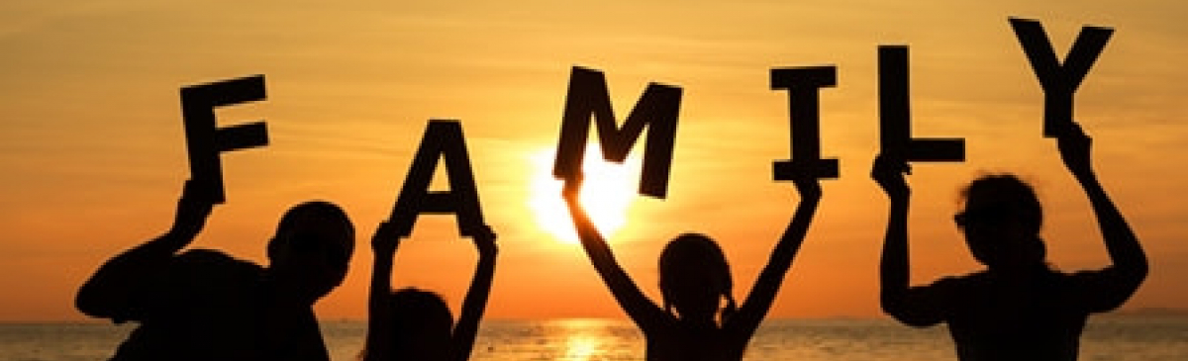
The Jewish people are a family. And like all families, sometimes we fight. We fight about important things; we fight about unimportant things; but disagreements never undermine our unity. On Friday, October 6th, Jews all over Israel were protesting. People disagreed on many issues. On Saturday October 7th, those disagreements were put aside and our unity as a people, as a family, became the most important thing worth fighting for.

Slide 23
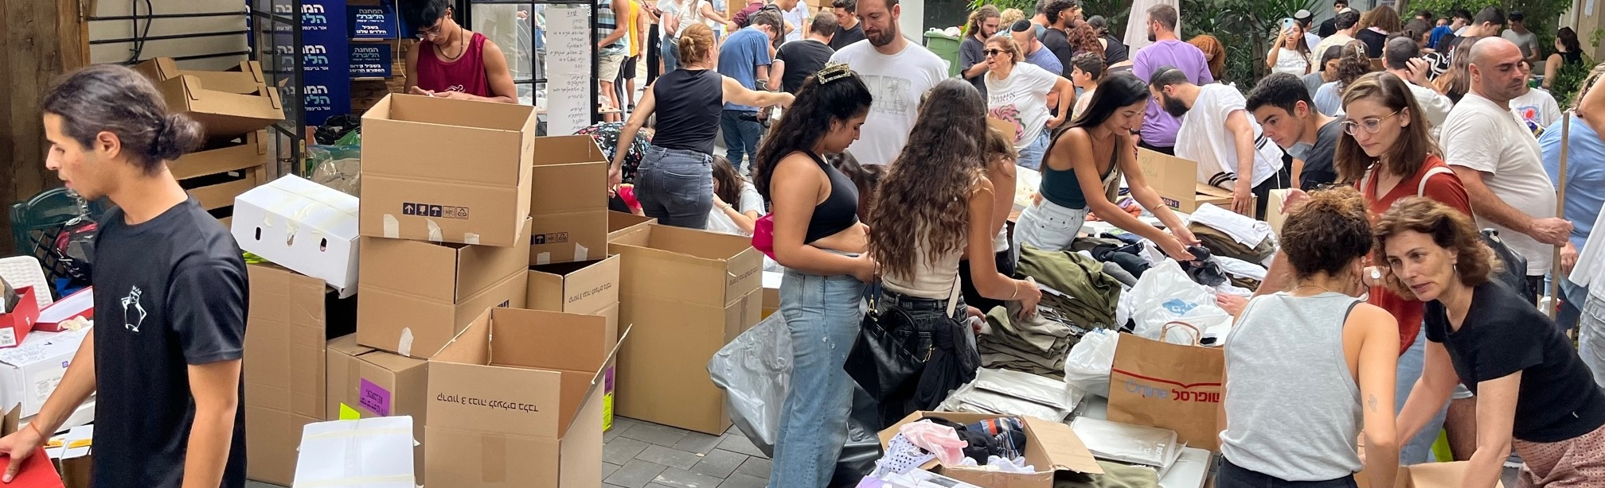
We are going to take a look at a few social media posts that have come out of Israel over the last several days that represent examples of unity amongst the Jewish people. Here in North America and around the world, Jewish communities are gathering together to pray, to send supplies, raise money, to do whatever is needed for our family living in Israel. Even if they are a family we’ve never met.

Slide 24
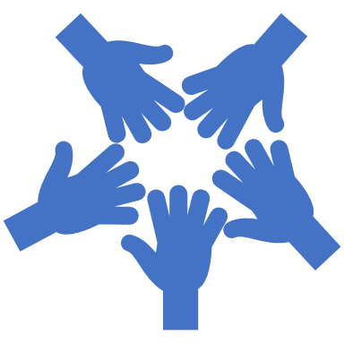
Unity, Achdut, Resilience, and Allyship.
Click Here

Slide 25
Share a few of the examples you saw of “regular people” showing unity and support for Israel.

Slide 26
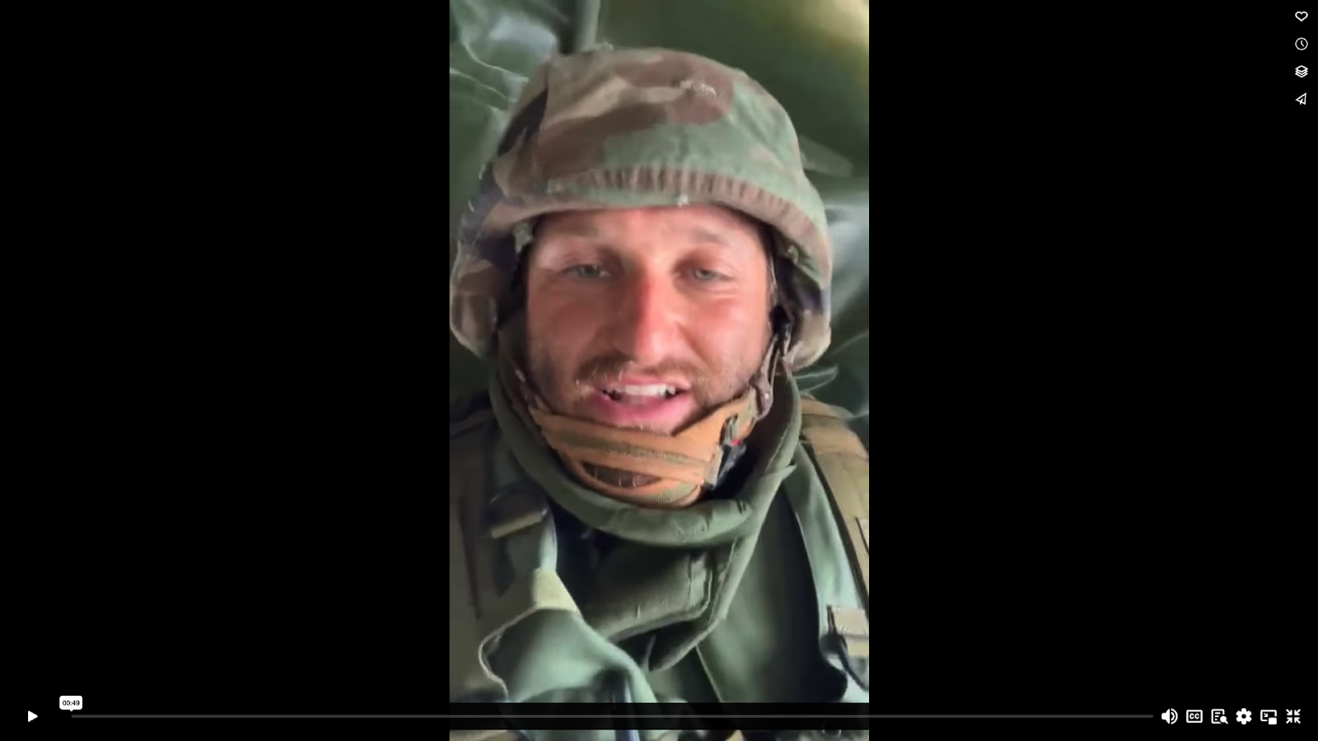
Be Somebody’s Light

Slide 27
How can YOU be somebody’s light?

