Slide 1
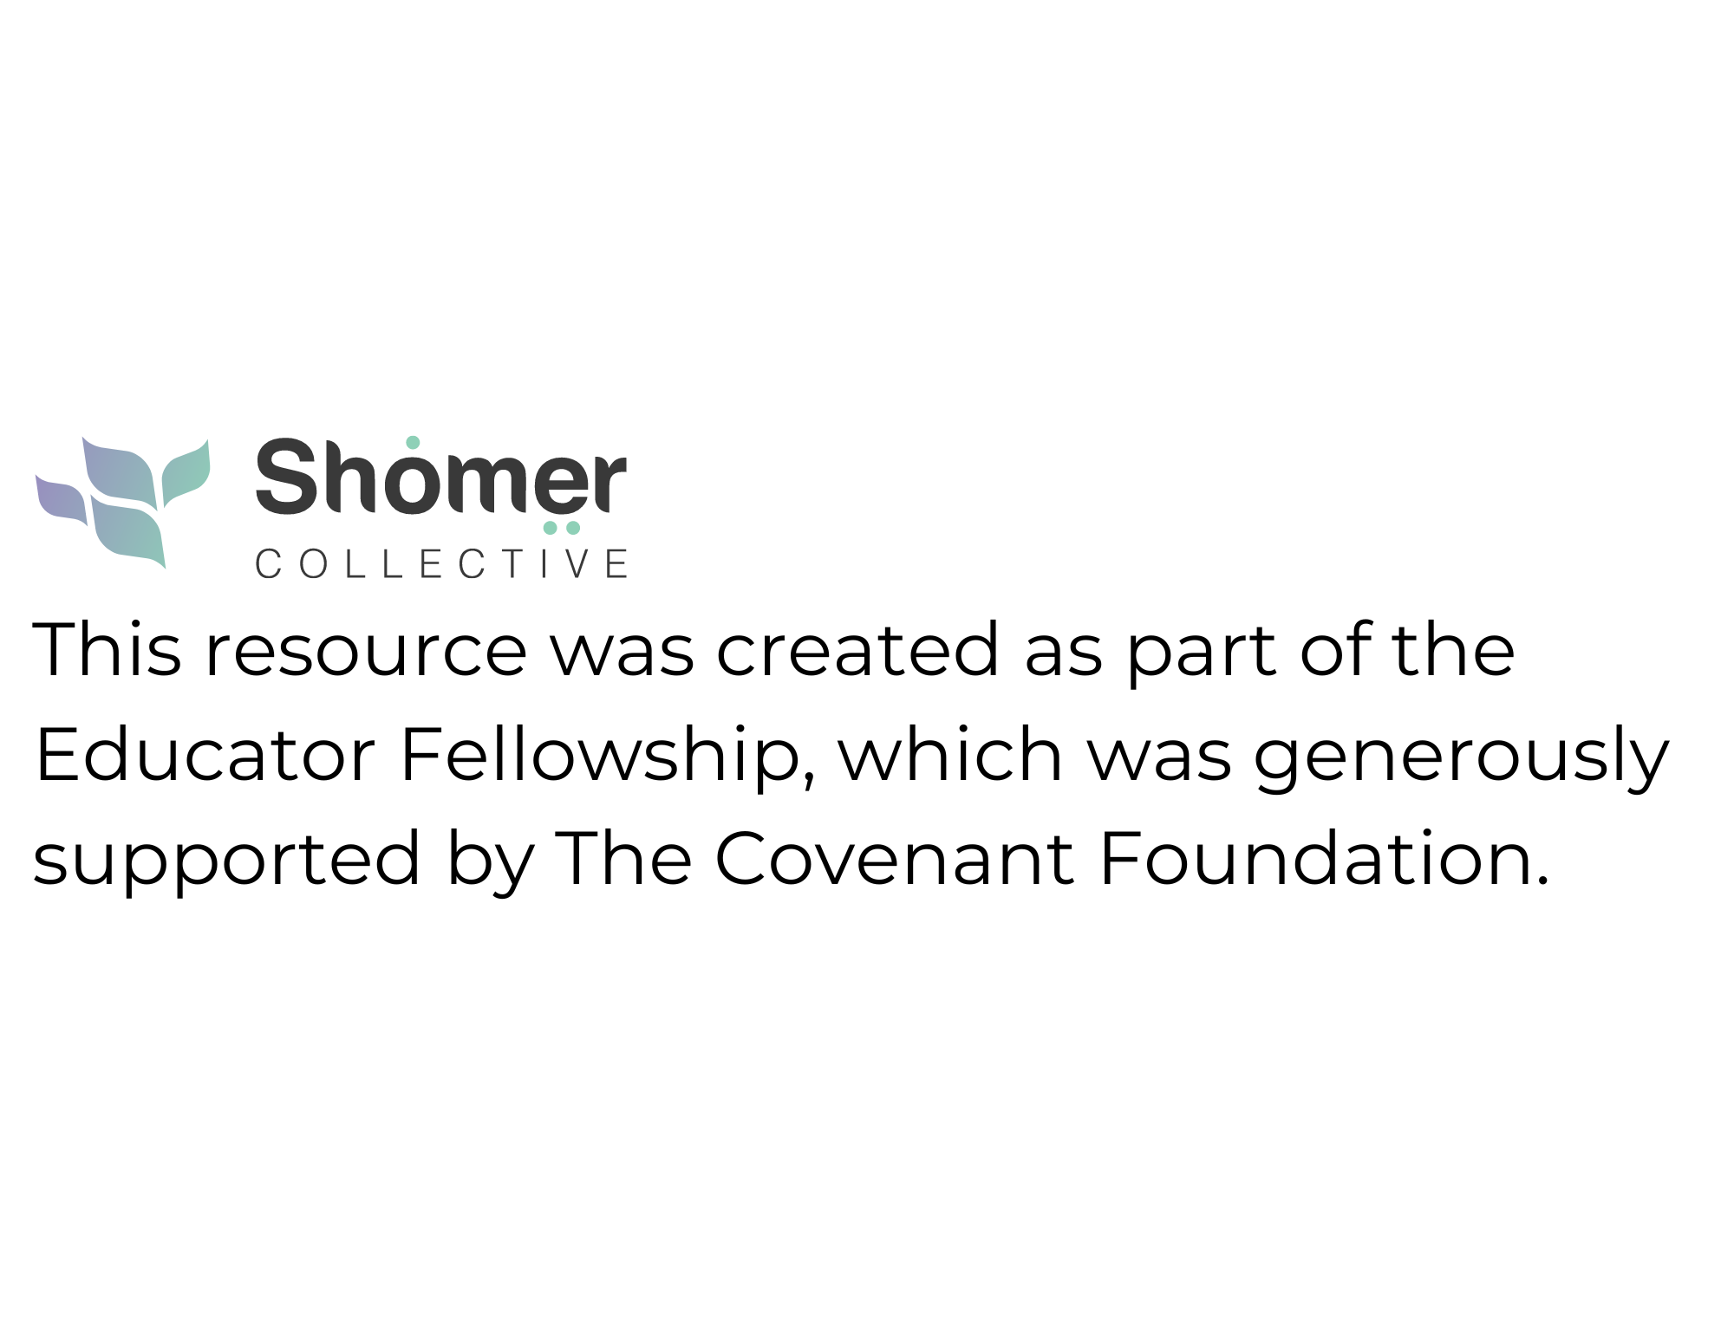


Slide 2
“Helping Little Hearts Heal”
Normalizing Death Talk with Kids
By: Ann Pircio Pardes
ann@wjcenter.org
561-400-7361

Slide 3
Learning Goals
As a result of our time together, you will:
Reflect on your personal comfort and boundaries on death.
Understand how young children perceive death.
Develop age-appropriate and honest language when speaking to children about death.
Recognize how and when to involve families.
Respect diverse family beliefs and cultural practices.
Weave in Jewish wisdom, values and customs as we support children and families.

Slide 4
Let’s Talk
It’s hard to talk about death.
It’s harder to talk about death with young children.
It’s better to be prepared before a crisis.
Together, we can normalize addressing the topic of death with young children through a Jewish lens.

Slide 5
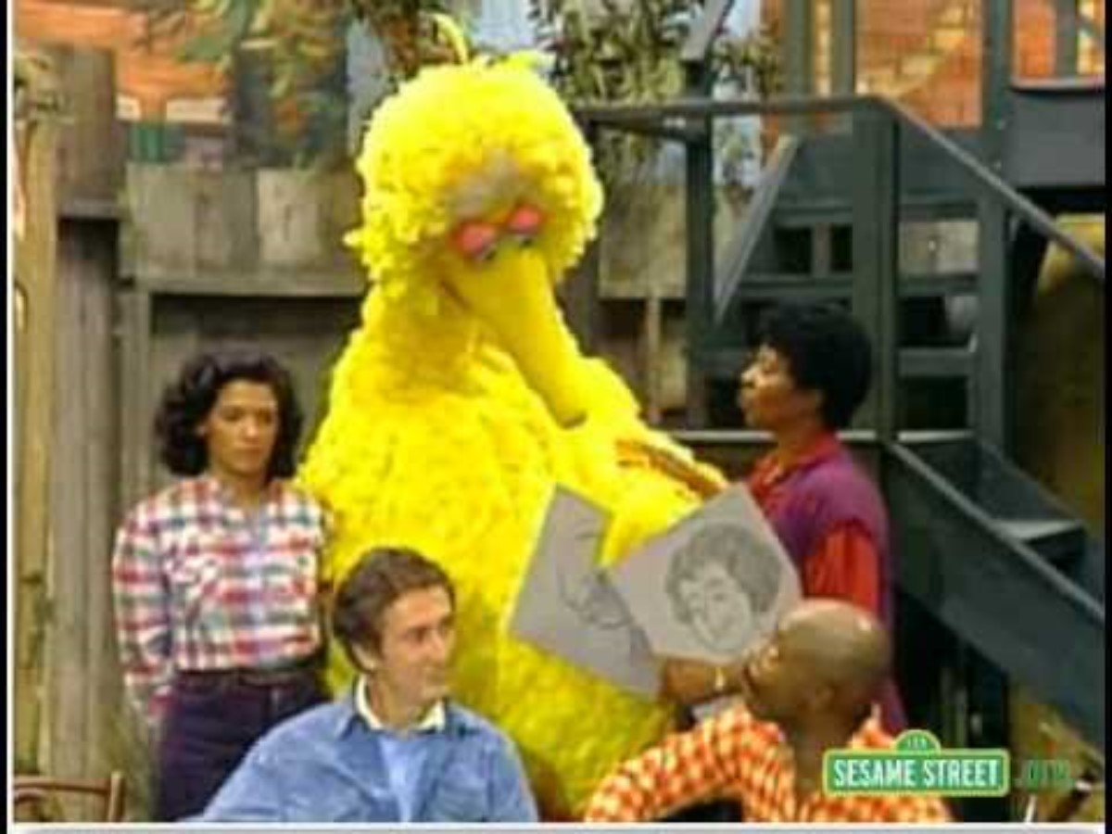
Goodbye, Mr. Hooper

Slide 6
What Do We Bring to the Conversation?
“Lindsay (4 years old) & the Worm”
What are your religious beliefs? Jewish vs. Christian vs. Atheist/Other
Have your beliefs changed over your lifetime?
What are your views on death?
What is your comfort level?
How do you see your role in supporting children in your classroom?
How do you see your role in supporting families?

Slide 7
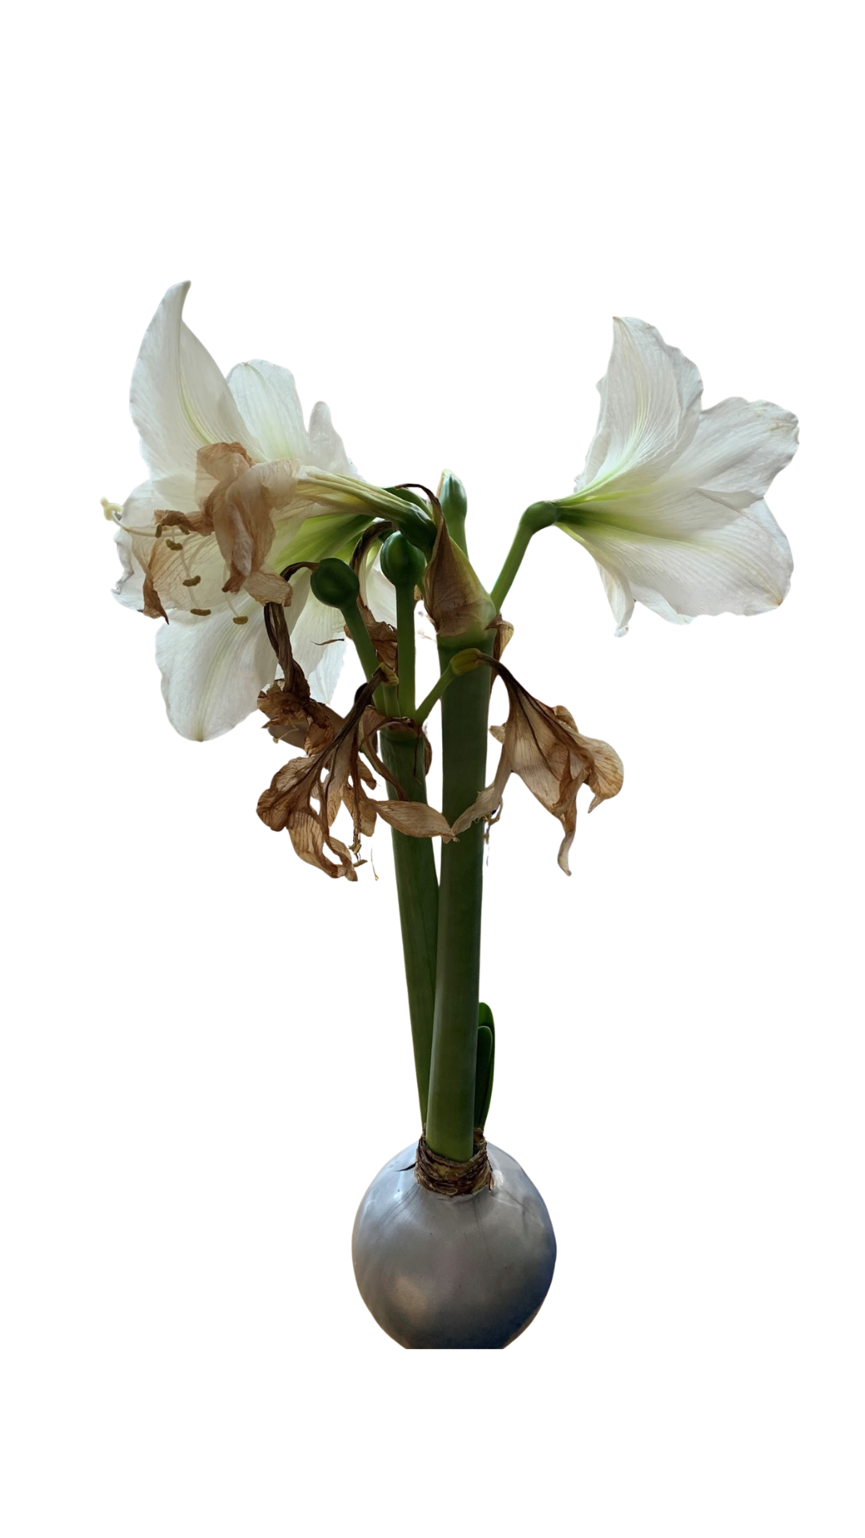
Cycle of Life
(Dor L’dor- Generation to Generation)
“Ginny Isn’t Coming Back to School”
Teaching young children about death in a Jewish context is less about giving complex theology and more about grounding them in core values: compassion, memory, and cycles of life.
In Judaism, life is seen as a natural cycle.
Connecting to nature helps children understand death as part of the world, not something scary or mysterious.
“All living things grow, live and eventually die.”

Slide 8
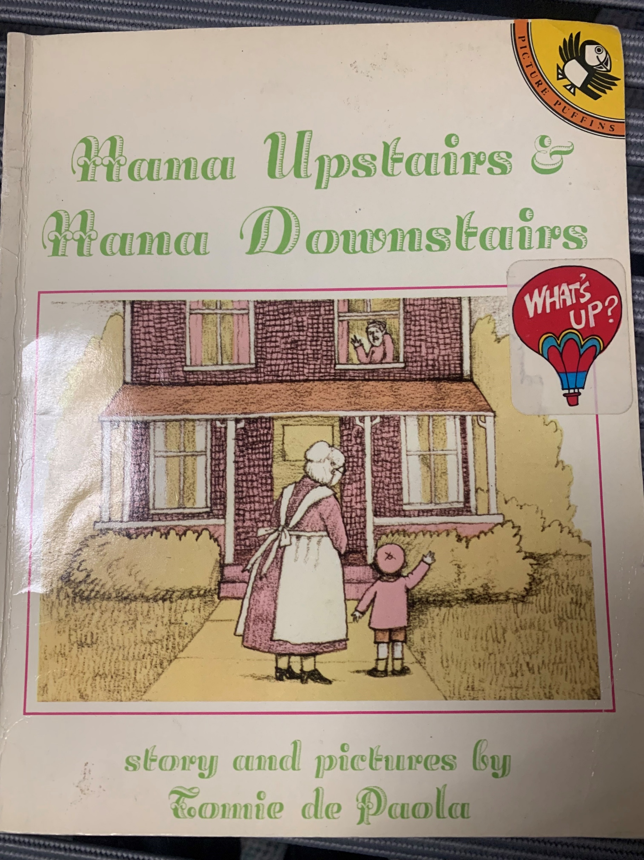
Zachor (Remembering)
“Mrs. Saxman Got Hit By a Bus”
Memory is a powerful Jewish value.
We can introduce simple remembrance rituals like lighting a candle, planting a tree or sharing a happy memory.
“Even when someone dies, we still remember them and talk to them.”

Slide 9
Let’s Stop Telling Lies
“Aunt Rachel Went to the Farm”
“D.E.A.D. Squirrel on the Playground”
Avoidant behavior
D.E.A.D
Shifting focus
Ignoring or shutting down questions
Hiding your feelings or showing excessive emotional intensity
Using euphemisms (went to sleep, passed away)
Too many details

Slide 10
Answering Children’s Questions
“Where’s Pipa?”
Know the child’s level of development.
Communicate with the family. Know what they’ve told the child.
Know the families religious background and culture.
Simple answers.
It’s ok to not know the answer.
Be prepared for surprises.

Slide 11
Helpful Tips
“Liam & Ava”
Use simple, clear language (died, dead)
Answer questions honestly
Allow emotional expression
Check for understanding
Don’t underestimate children’s level of understanding.
Offer reassurance about safety and routines
Follow the child’s lead. Kids jump in and out of grief.
Use books or stories
Validate and accept all emotions

Slide 12
When You’re Not Sure What to Say…
“Our Friend Jimmy”
“What do you think?”
“Tell me more…”
“Hmmmm…”
“Let’s think about it together.”
“Let me think on that and I’ll get back to you.”
“Just because...”

Slide 13
Nichum Aveilim (Comforting those who mourn)
&
Chaver/Dibbuk Chaverim (Being a good friend)
Judaism places a strong importance on caring for others who are sad.
We can encourage empathy by drawing pictures, giving hugs or saying kind words.
“When someone is sad because someone died, we help them feel less alone.”

Slide 14
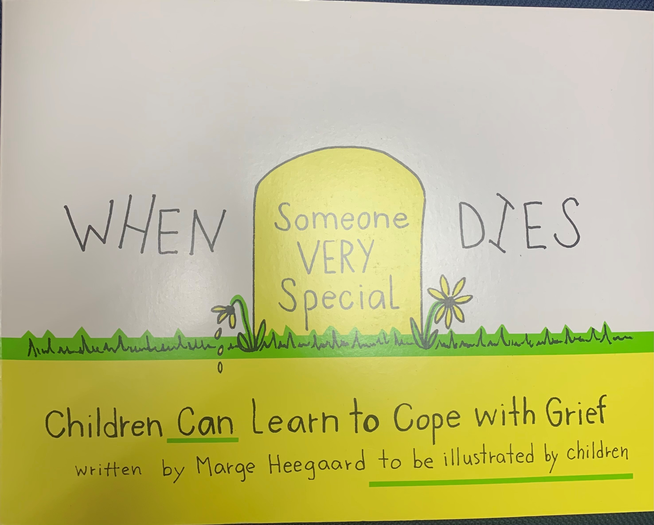
Shiva
(7 days of Mourning)
“Shiva is a special time when a family feels sad because someone they love died. Friends come to be with them, bring food and help them feel less alone.”
“Little Hearts Comfort Kit”
A shiva activity bag for kids!

Slide 15
2 Year Olds
How they understand death:
Do not understand permanence.
Experience death as separation.
Respond more to tone and routine than words.
What to say:
Use brief, concrete language.
Focus on what the child will experience.
Example language:
Grandma died. That means her body stopped working. We won’t see her anymore.
We feel sad. We might cry.
Key Tips:
Maintain routines, offer hugs, expect repetitive questions and/or regression.

Slide 16
3 Year Olds
How they understand death:
Beginning to understand loss, but not permanence.
Might think death is temporary or reversible (“magical thinking)
What to say:
Use brief, concrete language.
Simple explanations with repetition.
Gently correct misunderstandings.
Focus on what the child will experience.
Example language:
When someone dies, their body stops working. The don’t eat, sleep or feel pain.
It’s not something we can fix.
We feel sad. We might cry.
Key Tips:
Maintain routines, offer hugs, expect repetitive questions and/or regression.
Allow expression through play, drawing, or stories.

Slide 17
4 Year Olds
How they understand death:
Start to understand permanence, but inconsistently
Curious about details
Might worry about who will die next.
What to say:
Use brief, concrete language.
Reassurance about safety.
Focus on what the child will experience.
Example language:
When someone dies, their body stops working and can’t start again.
Most people live a long time. You’re safe and we take care of you.
We feel sad. We might cry.
Key Tips:
Address fears about abandonment and separation.
Normalize emotions: sadness, confusion, even laughter.
Allow expression through play, drawing, or stories.

Slide 18
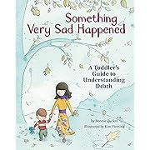
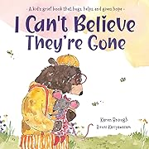
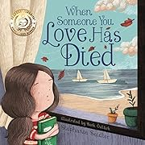

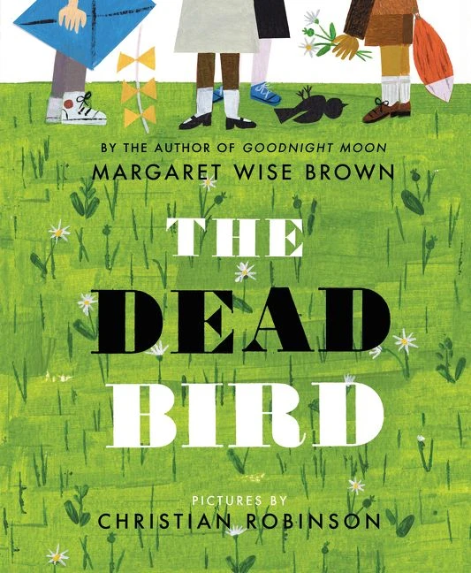
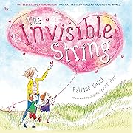
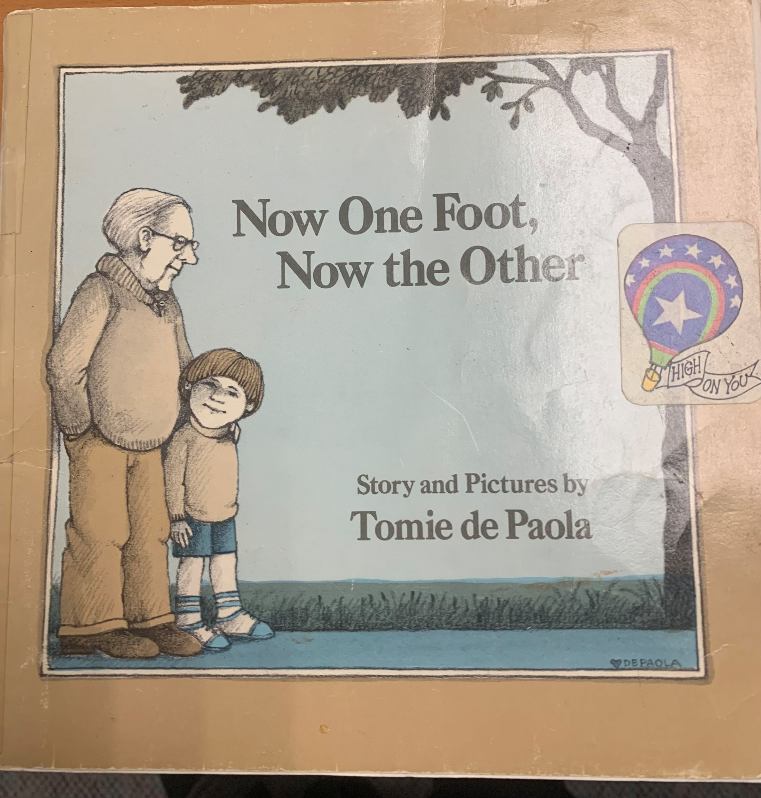
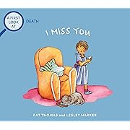
Some Resources

Slide 19
About Shomer Collective
Shomer Collective is a Jewish non-profit organization focused on transforming the culture around death, dying, and mourning by leveraging Jewish wisdom. They provide resources, workshops, and educational programs to foster open conversations, proactive planning, and supportive care for end-of-life experiences.

Slide 20
About the Educator Fellowship
My Fellowship was a 9-month, on-line cohort-based learning experience for Jewish educators from a variety of settings and backgrounds.
Together, we explored Jewish wisdom, texts and traditions about life and death, dying and mourning, guided by experts in the field.
We developed resources to help our communities talk more openly, more frequently, and with less fear and hesitation about death and dying.

Slide 21


